Slide 1
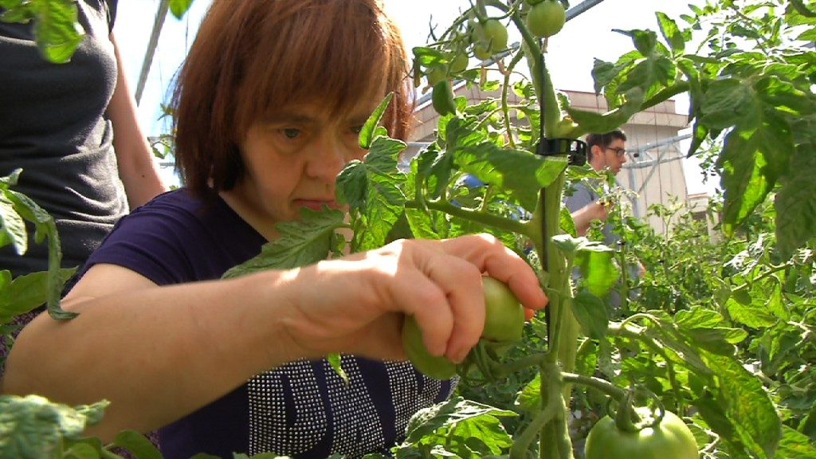
ROOFTOP GARDENS, THE SOCIAL DIMENSION OF A HORTICULTURE PROJECT
The Municipal Institute for People with disabilities
Barcelona City Council
1
Notes:
Benvinguda …
We have come to present a project that we think is important because it joins together in a single initiative technology for environmentally friendly gardening and social policies.
We are kind of “foreigners” in this congress because we come from a very different area of work. We work in the promotion of people with disabilities. It’s for this reason that we think it is important to explain a little about who we are, our job in the city of Barcelona and how we ended up at this congress today.

Slide 2
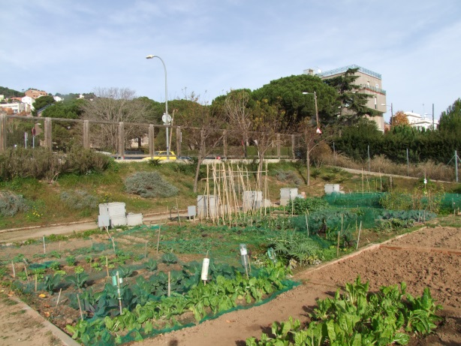
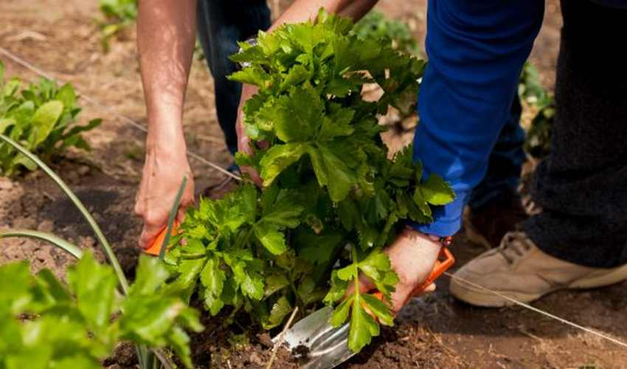
Project Background
18 plots of land for NGO of people with intellectual disabilities and/or mental disorders.
Barcelona as a high density city without the possibility of new ordinary plots.
2016 saw the start of the rooftop gardening experience for NGOs of people with disabilities.
Notes:
- Possible explicació de formacio i acollida de les entitats

Slide 3
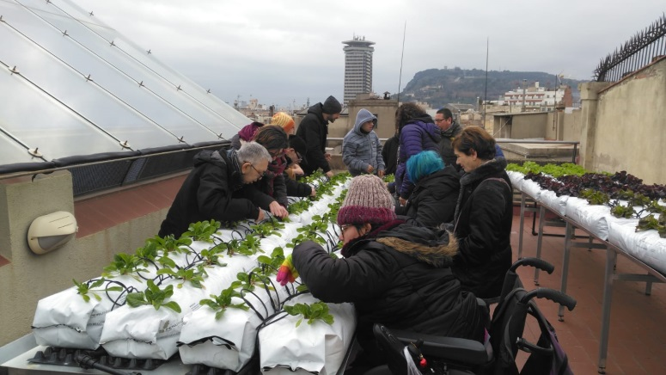
Main goals
The project consists of entities of people with disabilities managing hydroponic urban gardens on rooftops of municipal facilities.
Main goals of the project:
The promotion of people with disabilities in an area that brings benefits in different aspects (leisure, training, relationships, etc.).
Making use of disused spaces like the rooftops of municipal buildings
Contributing through these projects to creating a greener city.
Innovating in the management of water and soil in the city to obtain sustainable quality produce.

Slide 4
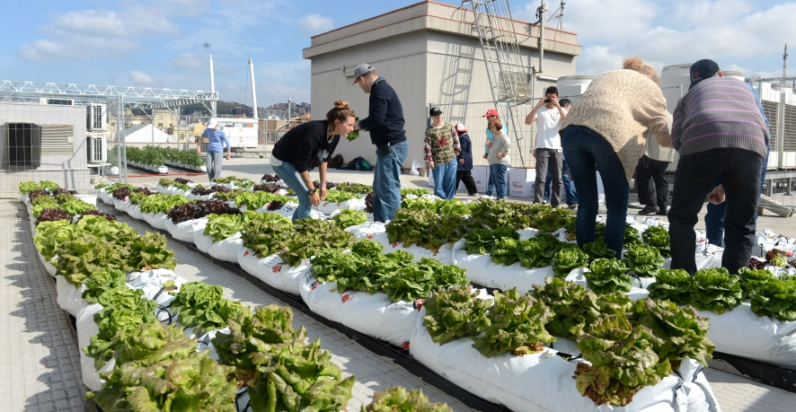
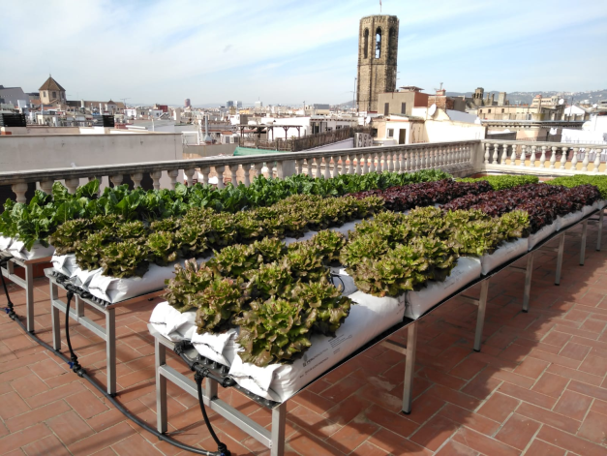
Implementation
April 2016 saw the start of the first rooftop garden project with NGOs of people with intellectual disabilities.
2. Since 2016, the project has grown up to 10 different plots in rooftops
Notes:
Explicar que hi ha una coordinació i un estudi previ per part de riscos laborals i del servei tècnic especialitzat del Districte.

Slide 5
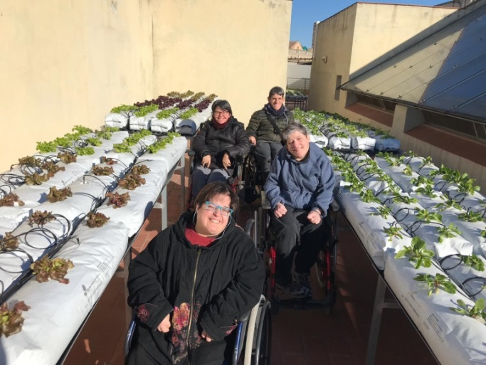
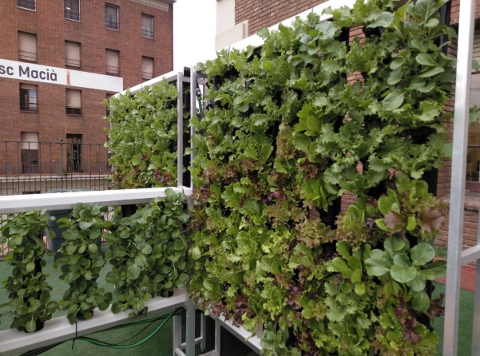
Implementation
Different profiles of disabilities participate in the project
4. In January 2020, first “spin-off” of the project. Construction of a vertical structure allotment in a school.

Slide 6
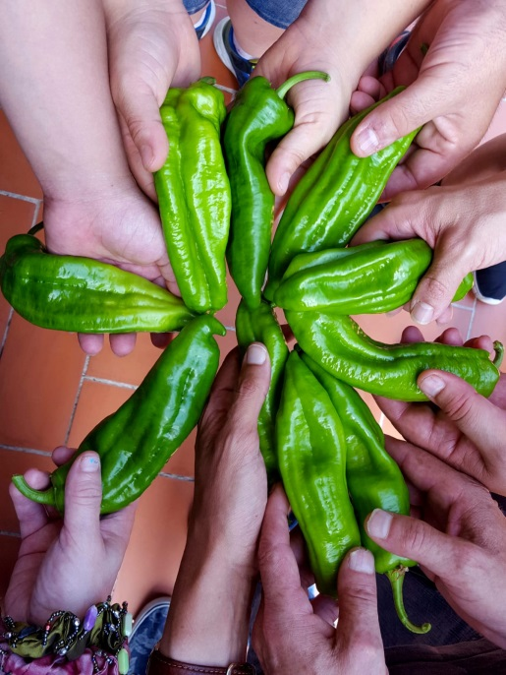
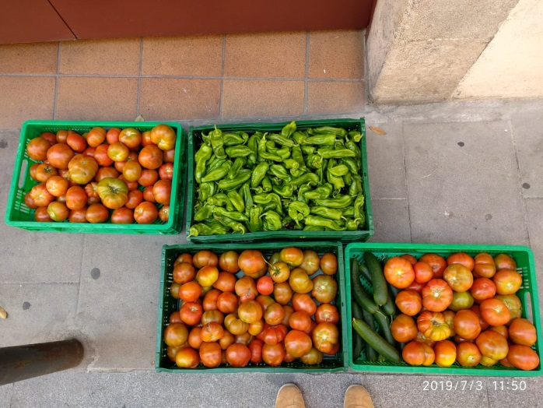
Some General Data
Different profiles of the people with disabilities
Various ONG share each allotment attending 1 day a week.
Type of crops: green vegetables, aromatic plants (14 different varieties)
Total production in 2020: 3590 Kg of fresh food.
Most of the production is given away to social canteens and food banks.

Slide 7
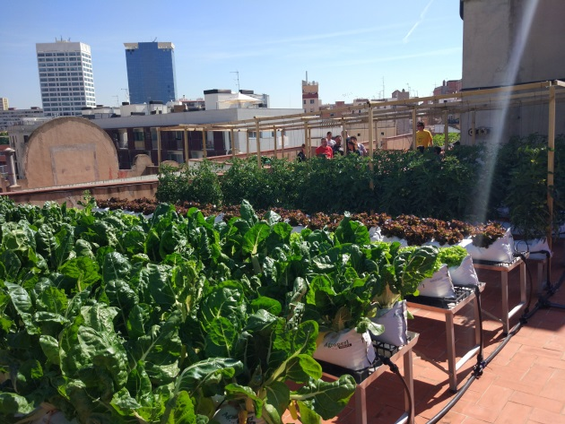
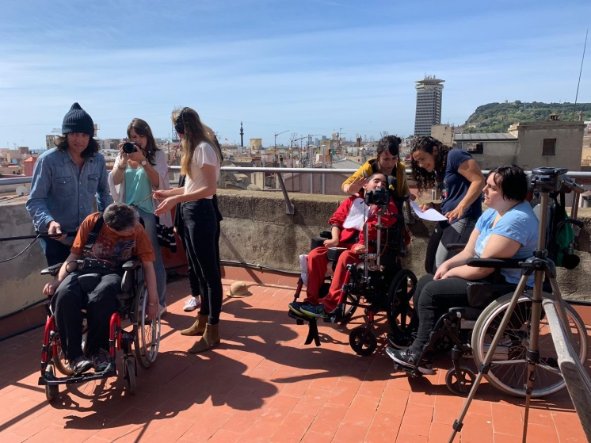
Stakeholders
Networking: participation of different professional profiles from the “third sector” and public administration.
21 participating NGOs of people with disabilities
Number of participants :
Year 2023: 250 farmers

Slide 8
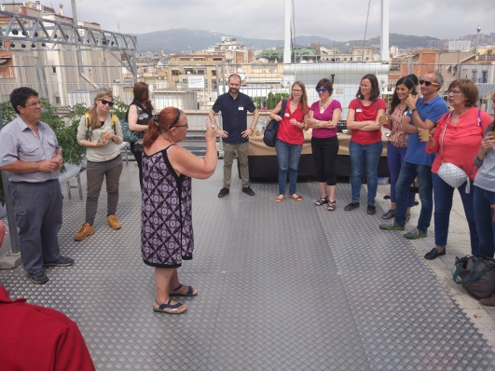
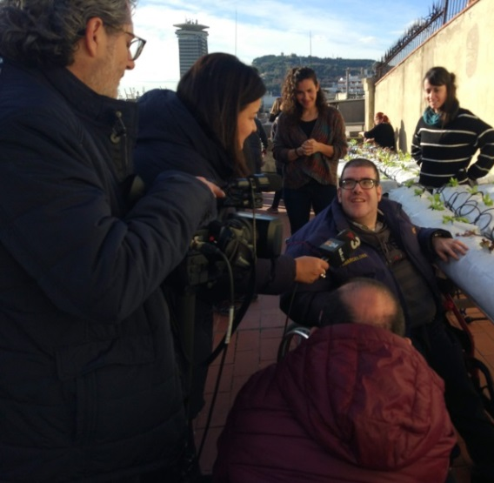
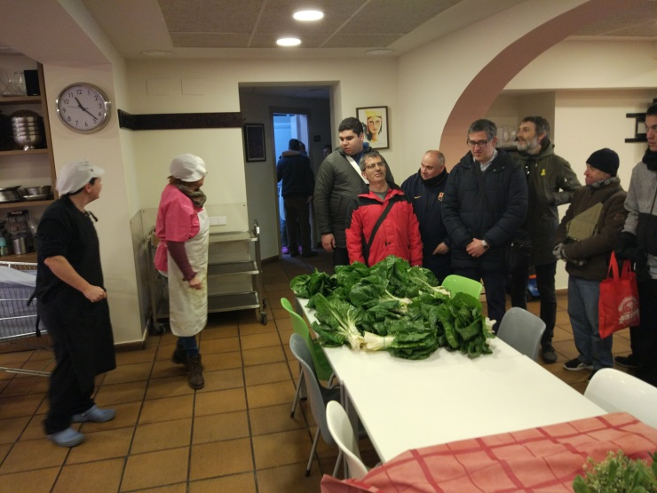
Stakeholders
Other relevant players:
Different departments of Barcelona City Council hosting gardens.
Enterprises in charge of the technical tracking, teaching and assessment.
Social canteens and Food Banks of the nearby territory
Derivative academic research

Slide 9
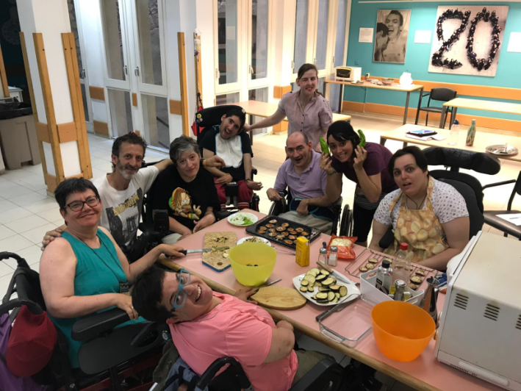
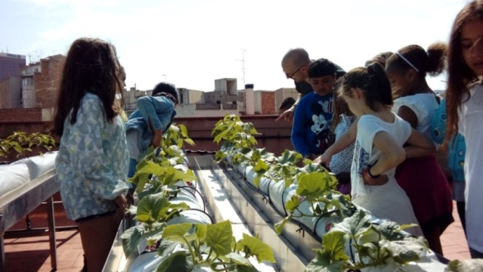
Success criteria
As a social innovation project, the initial objectives were focused on:
Improvement in the quality of life of the participants
Innovation in the use of hydroponics and testing the food quality of agronomic production in the city.

Slide 10
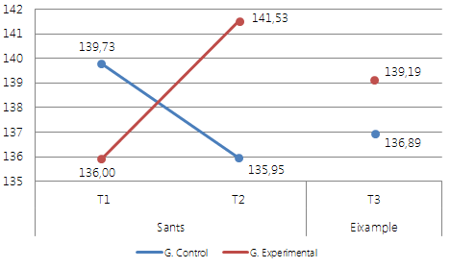
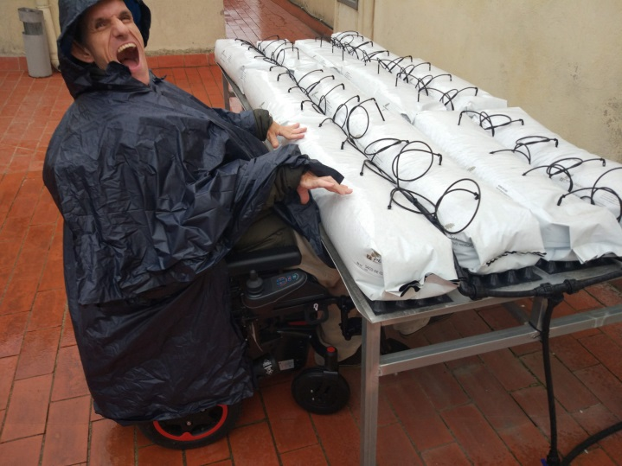
Results compared to success criteria
1.- Sociological study (2020).
Main results: Improves quality of life index (5 points increase).
Verification of the role change of the participating users
Notes:
(BM), benestar físic (BF), benestar emocional (BE), Autodeterminació (AD), desenvolupament personal (DP), relacions interpersonals (RI), inclusió social (IS) i drets (DR). A partir de totes elles s’obté un nivell general de qualitat de vida (QV). relacionalformativaemocional

Slide 11
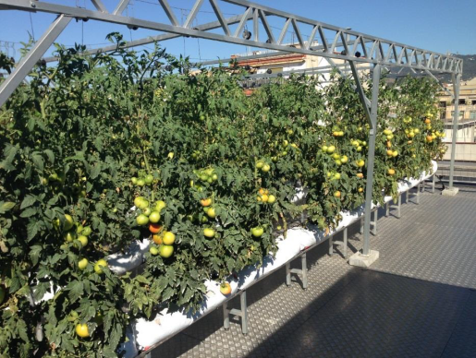
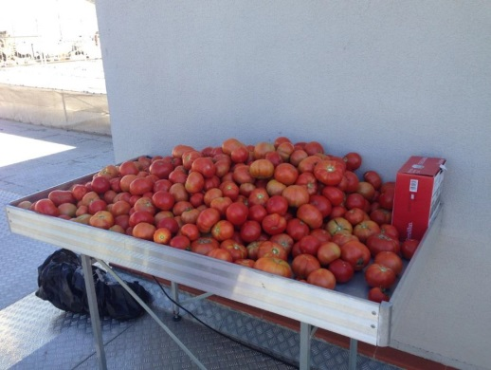
Results compared to success criteria
2.- Agronomic study (2020)
Main results:
Healthy foods promptly treated with phytosanitary products suitable for organic farming
Control of consumption, recirculation of water and reuse of nutrients.
High productivity outcomes.

Slide 12
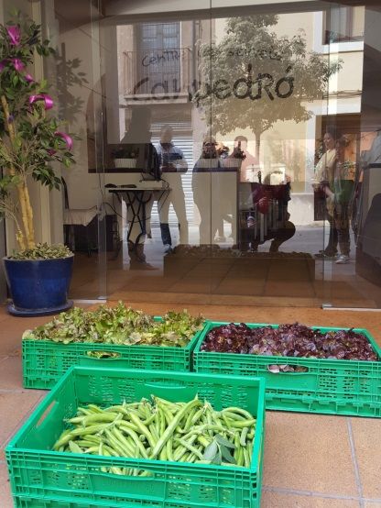
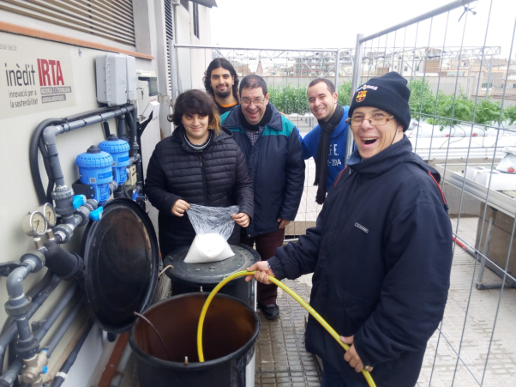
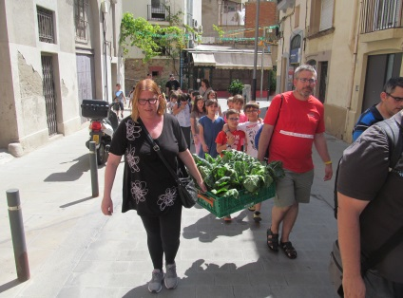
Results compared to success criteria
Improvements based on the evolution of the project
Giving production surplus to vulnerable groups, thereby improving the quality of their food.
Improvement in accessibility of municipal roofs and infrastructure.
Greater variety of cultivation (cucumber, pepper, beans, courgettes ..)
Increase in the tasks of the participants

Slide 13
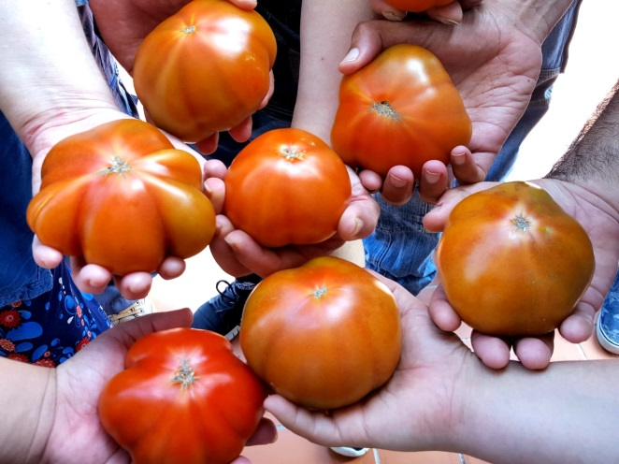
Adaptability
Development of a work methodology successfully replicated in each rooftop garden.
Adaptation during the pandemia COVID – 19.

Slide 14
Thank you for your attention!
Municipal Institute for People with Disabilities

