Slide 1
NEB Prizes 2026
Application Bootcamp
Date 11th March, 2026 – STRAND B - RISING STARS

Slide 2
4 CATEGORIES
Enhancing Circularity, Sustainability, and Innovation
Strengthening Local Democracy and Inclusion
Arts, Culture, and Heritage as Drivers of Change
Enablers for New European Bauhaus Transformation
1 SPECIAL PRIZE
Water Resilience
LINK TO DEFINITION OF THE 4 CATEGORIES and of WATER RESILIENCE
LINK TO ELIGIBILITY CRITERIA
INTERNATIONAL TRACK
Brazil
Japan

Slide 3
Place-based and beyond
The project you apply with can be...
A place-based project already executed in a specific location (e.g. a refurbished building)….
….but also
An innovative tool, material, design, method, learning approach, policy instrument, a governance model, a financial scheme, that has already been implemented in a given location/ market - and can enable physical, cultural and social transformation in line with the NEB values and working principles

Slide 4
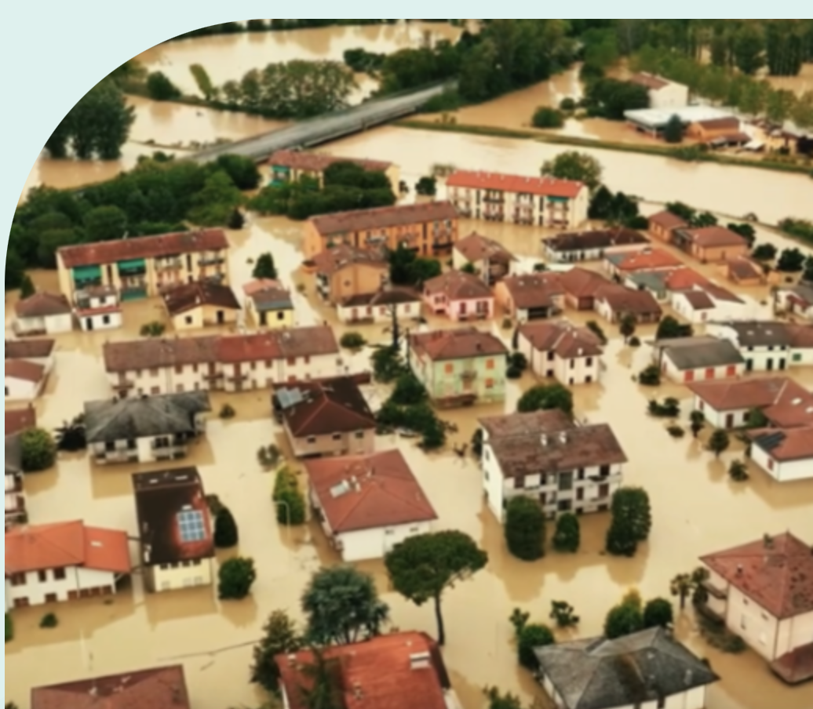
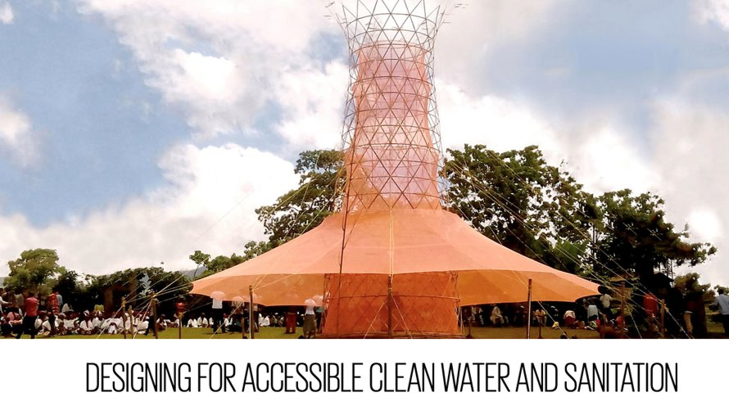
Water resilience - Examples
Place-based and beyond
Aqua Green, Faenza, Italy
Warka tower

Slide 5
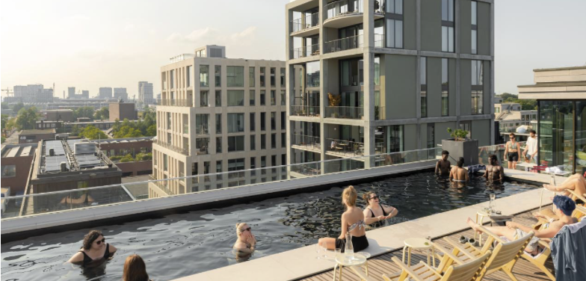
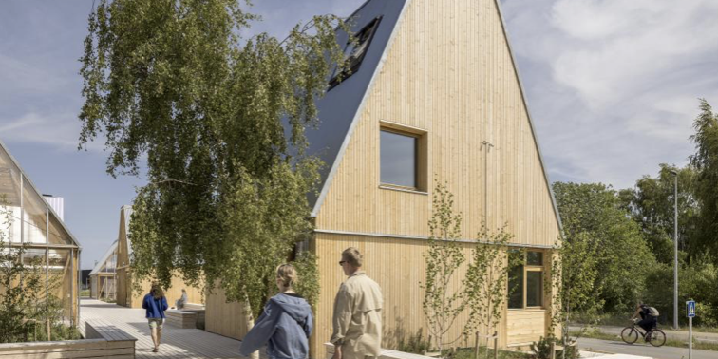
Enhancing Circularity, Sustainability and Innovation
Examples - place-based and beyond
Republica, Amsterdam North
Living Places, Copenhagen

Slide 6
OK,
READY TO START!

Slide 7
STRUCTURE OF THE APPLICATION FORM
I. PROJECT OVERVIEW | PROJECT TITLE & SHORT DESCRIPTION INFO (GEOGRAPHY, PARTNERS, APPLICANTS ETC...)
II. DETAILED DESCRIPTION | TELL US ABOUT YOUR CONCEPT TELL US A STORY ABOUT YOUR CONCEPT
III. ADHERENCE TO THE NEW EUROPEAN BAUHAUS | NEB VALUE: SISTAINABILITY NEB VALUE: AESTHETICS NEB VALUE: INCLUSION NEB WORKING PRINCIPLE: PARTICIPATORY NEB WORKING PRINCIPLE: MULTILEVEL GOVERNANCE NEB WORKING PRINCIPLE: TRANSDISCIPLINARY
IV. EU COMPETITIVENESS | BUSINESS MODEL SCALABILITY AND TRANSFERABILITY

Slide 8
TIPS TO ALWAYS KEEP IN MIND
BEFORE YOU START WRITING, FAMILIARISE WITH THE STRUCTURE AND THINK ABOUT WHAT YOU WANT TO COMMUNICATE – AND IN WHAT SECTION - TO AVOID REPETITION
WRITE A STORY HAVING THE RECEIVER IN MIND
PROVIDING CONCRETE EXAMPLES STRENGTHENS YOUR STORY TELLING
FOCUS ON RESULTS AND IMPACT MAKES YOUR CONCEPT CONVINCING
USE DATA AND QUOTES FROM USERS TO BACK UP YOUR CLAIMS
YOUR CONCEPT IS NOT JUST A CONCEPT – BUT AN EXAMPLE OF HOW TO REALISE THE CLEAN TRANSITION
Notes:
why should the rest of Europe be interested in your project.

Slide 9
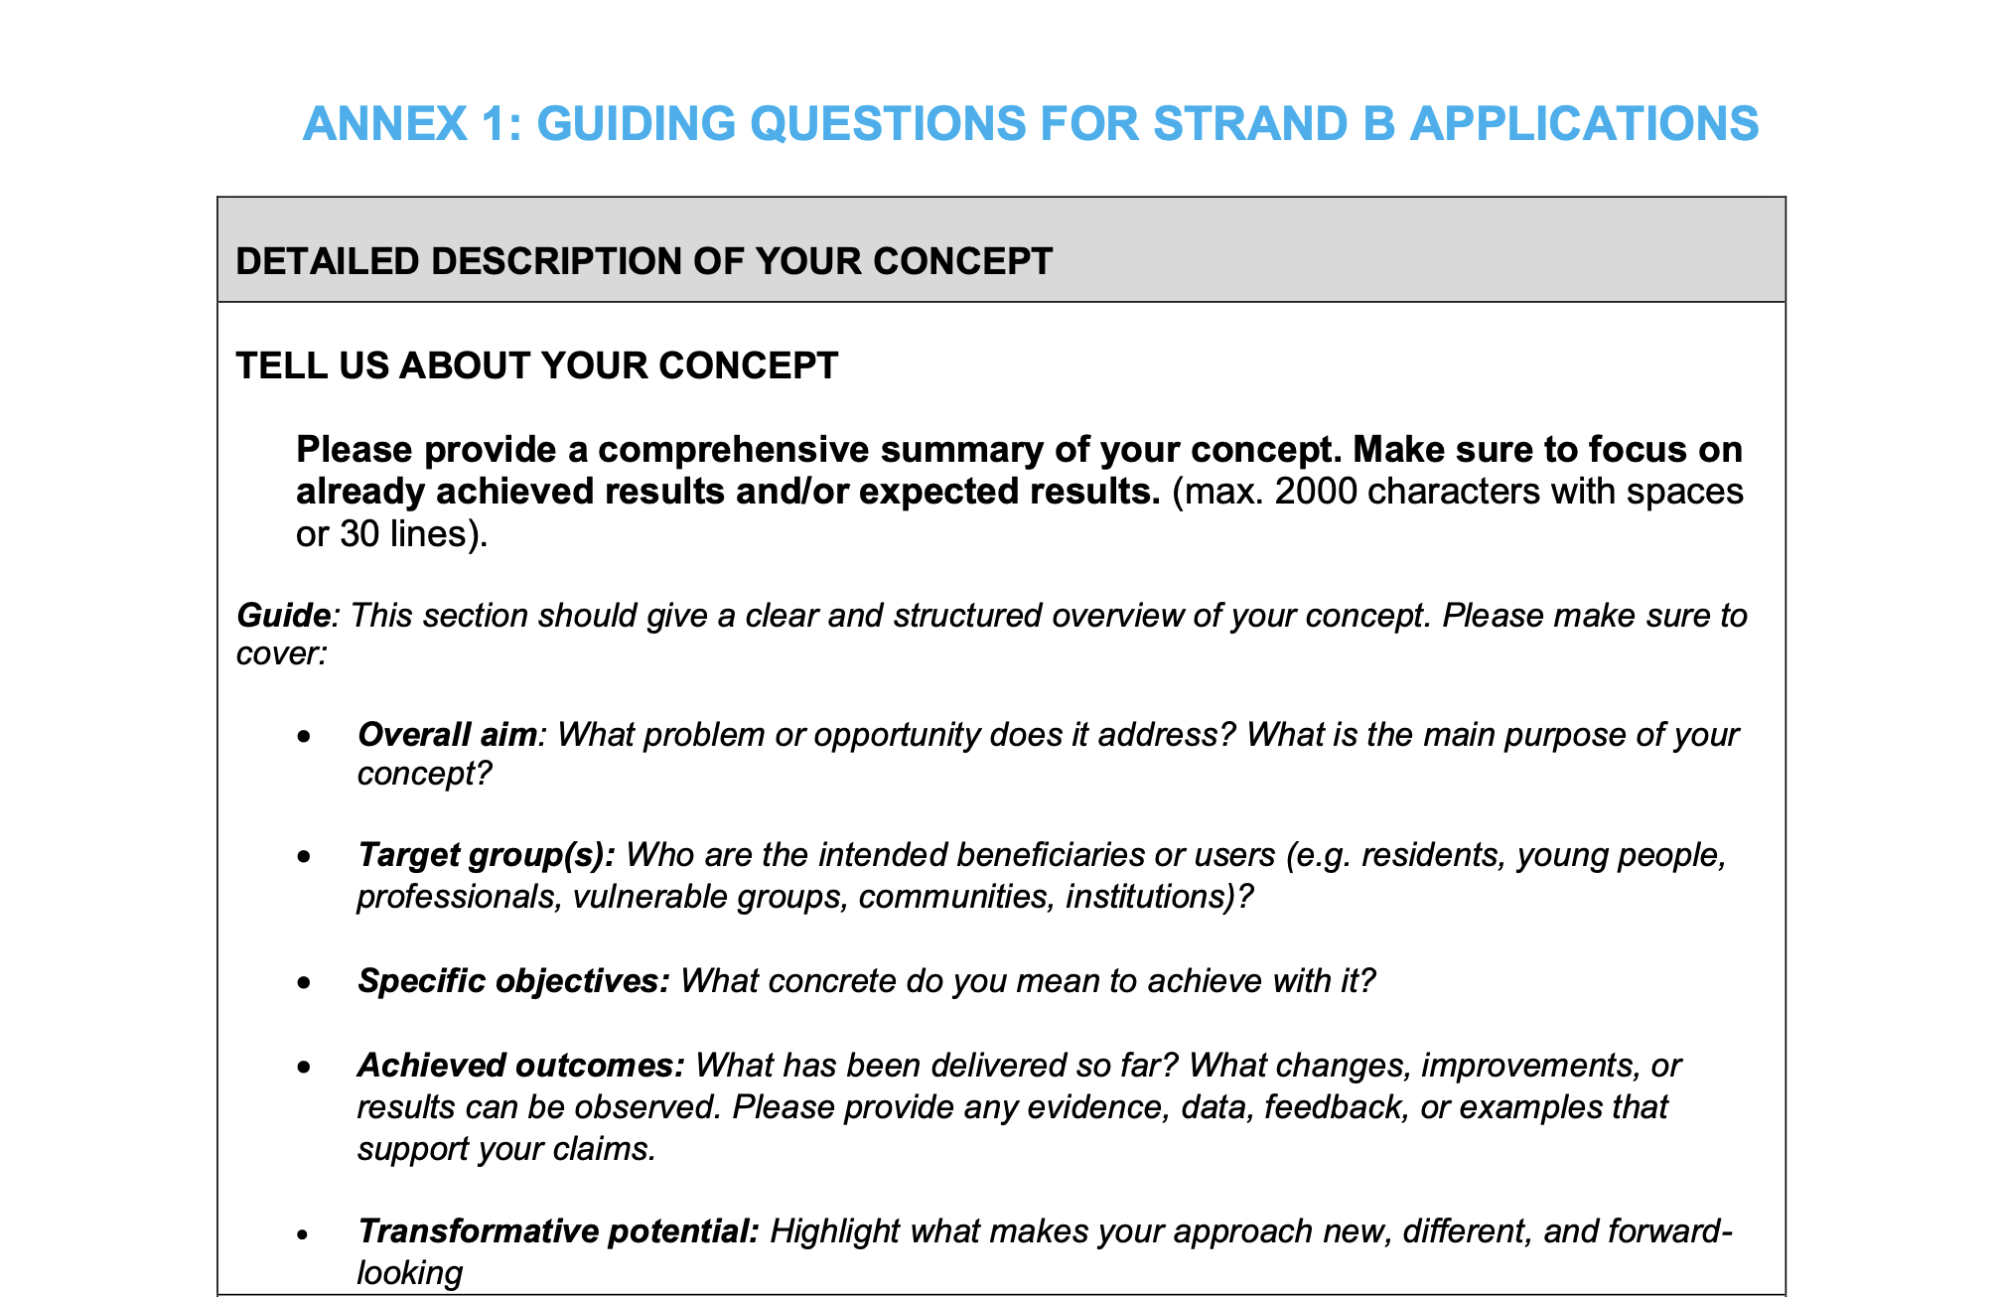
GUIDES TO APPLICANTS - ANNEX 1

Slide 10
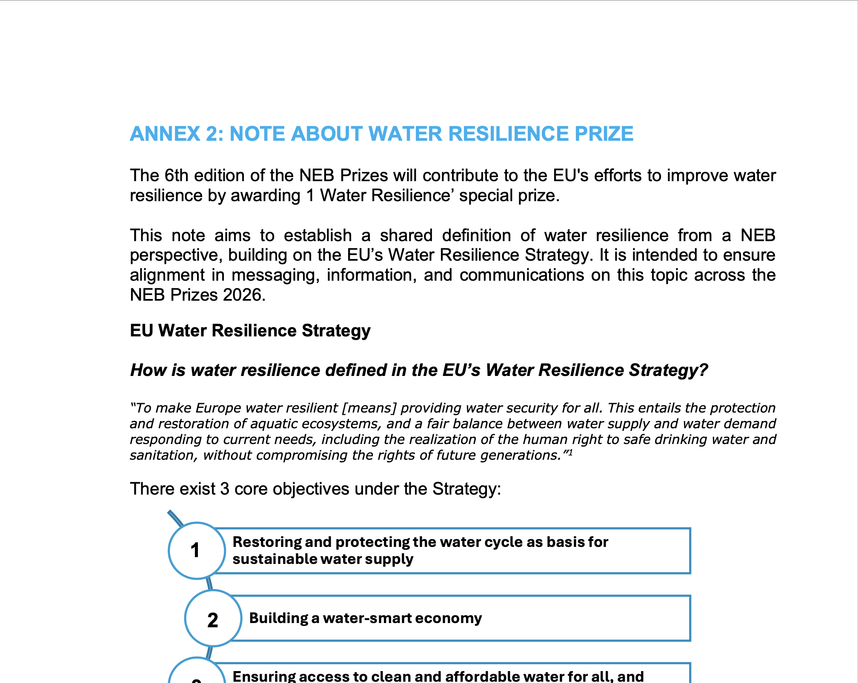
GUIDES TO APPLICANTS - ANNEX 2

Slide 11
I. SECTION – PROJECT OVERVIEW

Slide 12
Question – short & engaging description
TIP. write this text in a way that everybody can understand. Short and simple sentences, that get the reader curious.

Slide 13
II. SECTION – DETAILED DESCRIPTION

Slide 14
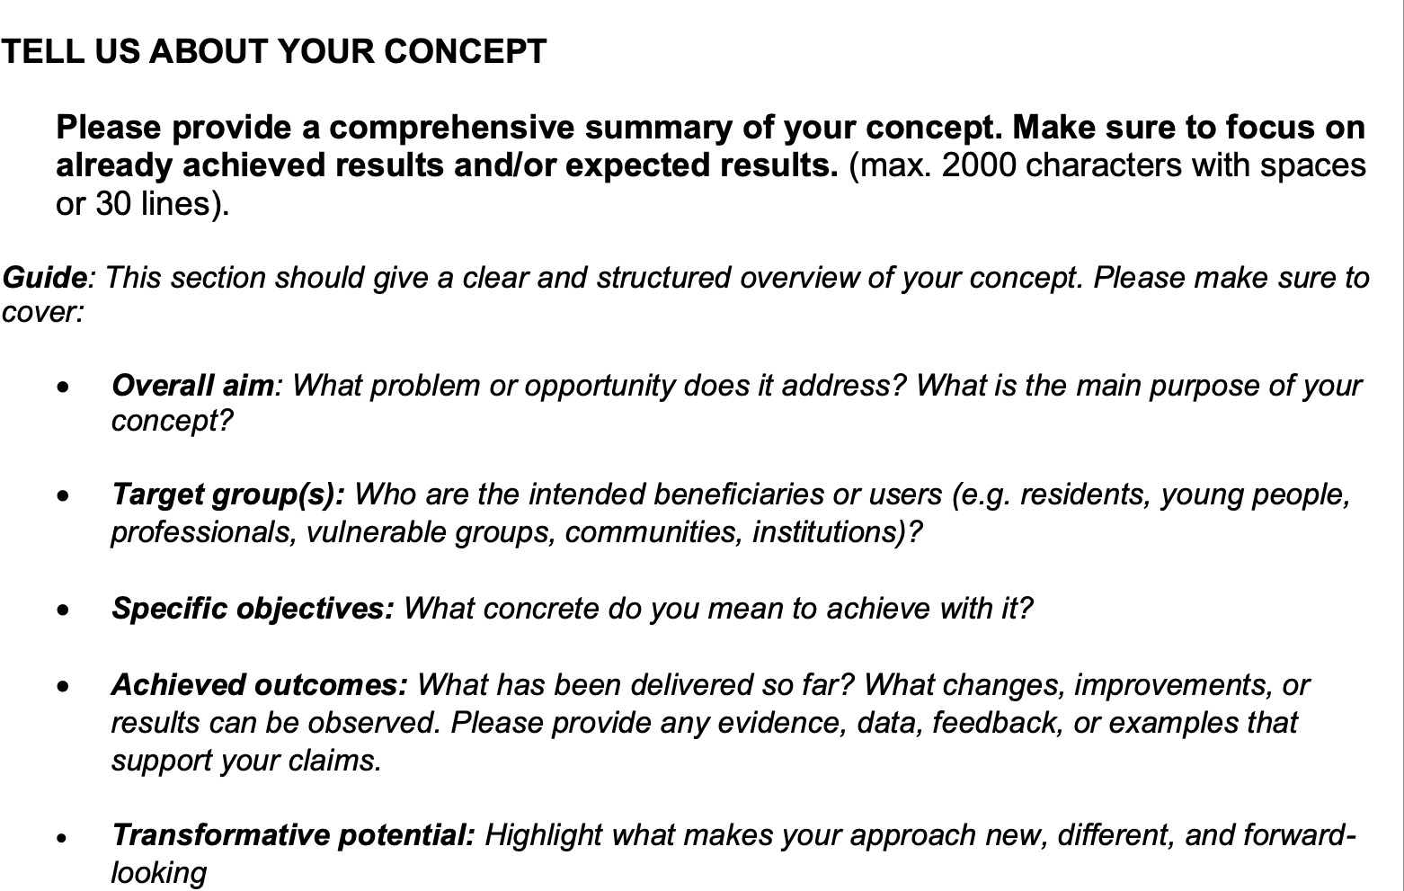
Question – Tell us about your concept
TIPS:
A short description that allows the reader to picture your project in their head
A longer description of achieved results (that can be seen now)
A longer description of impacts (that will materialise soon or in the future based on current set up)

Slide 15
Answer from a previous winner
The scheme delivered a light-touch redesign of the Kopli Community Centre’s courtyard. The Centre had remained largely abandoned since the 1990s, with the exception of a community garden and a Soviet-era outbuilding, partially converted into a free public Makerspace in 2022.
Currently undergoing rapid gentrification, the area lacks versatility in its free accessible public amenities. Mono-functional playgrounds and unkempt parks fail to serve the social needs of the vulnerable target groups – young families and non-Estonian- speaking residents. The previously overgrown, inaccessible grounds of the courtyard limited their use for larger events and daily leisure. Multiple hazard points (scattered debris, staircases at risk of collapse, etc) had also begun to hamper families’ involvement in events, as children could not be left to play without supervision in the contained courtyard, otherwise a prime space for independent play.
The redevelopment thus elevated a simple maintenance task to a design challenge, showcasing the social and architectural potential of otherwise mundane repair work in gradually reactivating underutilised sites. Through various short and long-form engagement activities, the design was guided by the community’s values of re-use and inclusivity and ultimately delivered using 100% re-used materials. Alongside delivering a physical community space for expanded cultural activities, the project laid the groundwork for city-wide strategies on the meanwhile use of neglected public assets, the involvement of communities in co-designing their regeneration, and the salvage and circular use of construction waste.

Slide 16
III. SECTION – ADHERENCE TO THE NEB

Slide 17
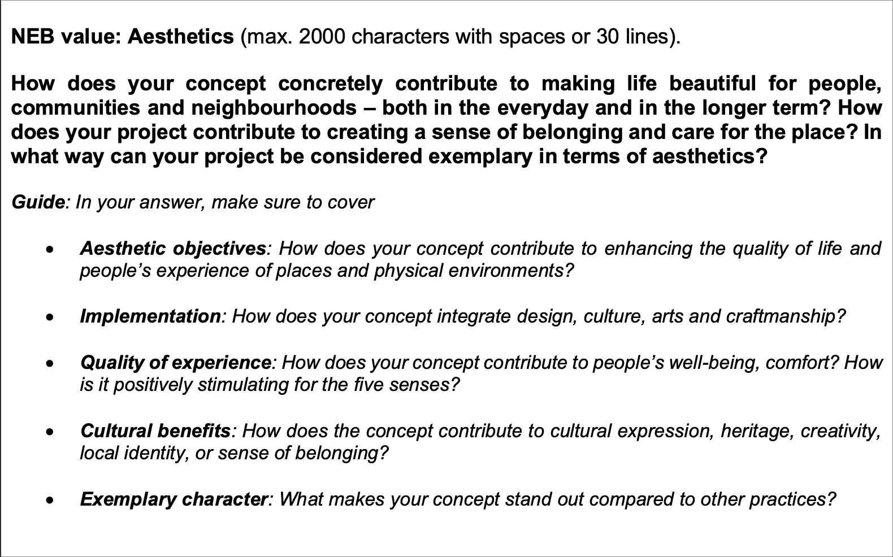
Question - Aesthetics
TIPS:
Aesthetics can feel fluffy – provide concrete examples to make the reader better understand your project
Evidence and data to back your claims up, and quotes from users and stakeholders of your project is a strength
Focus on one aspects of aesthetics at the time - from material to social and emotional

Slide 18
Answer from a previous winner
Promprylad is a unique example of how industrial heritage can be transformed into an aesthetically appealing and culturally vibrant space that enhances the quality of experience for people. The project preserves the authenticity of the former factory while integrating modern design elements that foster creativity, collaboration, and well-being.
The key aesthetic objective was to maintain the historical identity of the building while making it welcoming and functional. The design team carefully restored original industrial elements—exposed brick walls, steel structures, and large factory windows—blending them with contemporary architecture, sustainable materials, and open-plan spaces. This creates an atmosphere that is both inspiring and comfortable.
Another critical objective was to ensure a human-centered experience. The spaces are designed to encourage interaction, creativity, and productivity. Flexible layouts allow for different uses, from co-working and educational programs to cultural events and community gatherings. Natural light, greenery, and open areas enhance well-being and provide a connection to nature within an urban environment.
Art and culture play a central role in Promprylad’s transformation. The project hosts exhibitions, performances, and artistic interventions, making culture accessible and integrated into everyday life. Local artists contribute to the space’s identity, ensuring that it reflects the city’s creative pulse.
Promprylad is an exemplary case of how design can shape experiences, revive industrial heritage, and build a strong cultural identity. It serves as a model for rethinking urban spaces—not just as functional areas but as places that inspire, connect, and enrich communities.

Slide 19
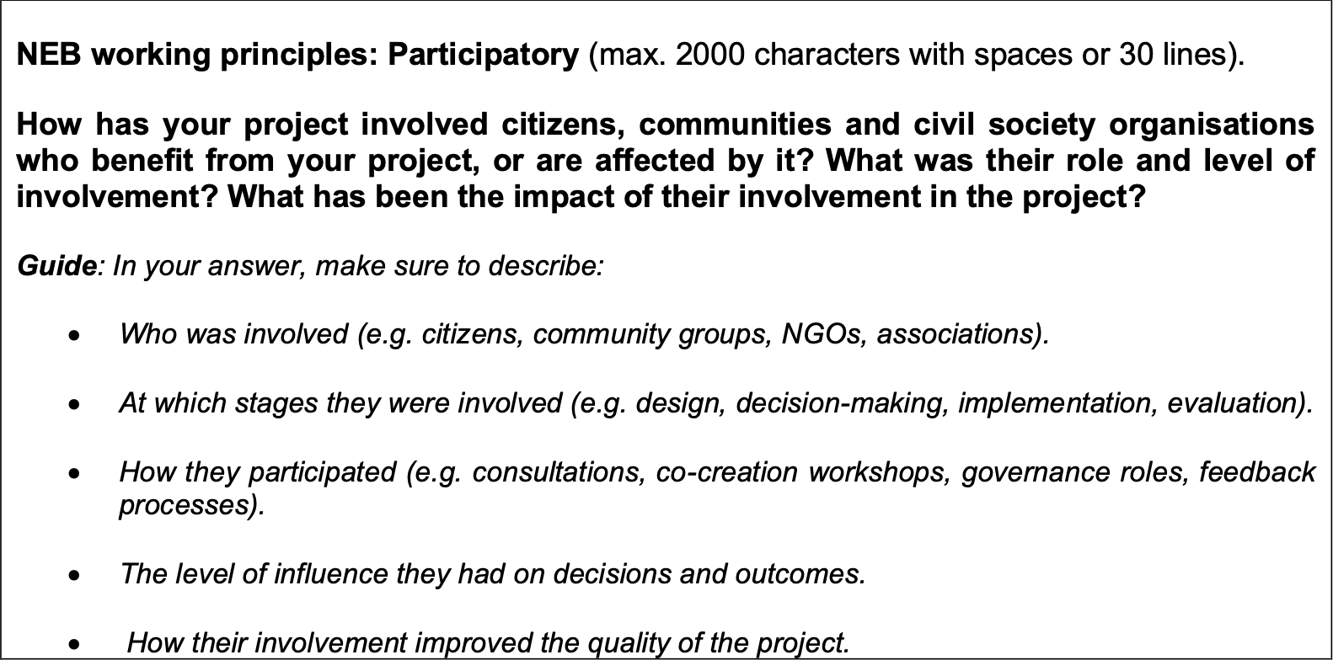
Question – Participatory
TIPS:
Describe how participation had a positive impact on the participants e.g. boosting their self-confidence, contributing to learning, creating agency and sense of care for the final product
Highlight the innovativeness of your participatory methods

Slide 20
Answer from a previous winner
Pollino transforms urban signage into multifunctional habitats for wild pollinators, specifically solitary bees, by integrating modular nesting spaces and floral elements.
Pollino’s deployment in Budapest’s 12th district sparked an organic, community-driven dialogue about pollinators and urban biodivesity. Through informal encounters during regular site visits, residents expressed curiosity and shared their enthusiasm over the visually appealing design and novel concept of integrating ecological functions into everyday urban elements.
Many revealed that pollinators, particularly solitary bees, were largely unknown to them and they often confused them with wasps or assumed that they primarily lived in rural environments away from cities.
These interactions revealed an important area for public education and knowledge dissemination.
While no formal workshops were conducted, Pollino’s pilot installations created an accessible platform for learning about urban biodiversity. Local residents and passersby asked insightful questions about how the installations worked, the role and lifestyle of various bee species, and how they could contribute to pollinator conservation or build bee-friendly environments in their own homes.
With each installation, Pollino offered residents an immediate connection to nature – one that is not only educational but practical.
Through these engagements, the project also proved its potential as an educational tool targeting a broad, diverse audience. For example, questions about bee pastures shed light on the misperceptions people had, opening the door for future participatory initiatives centered on effective community education. Despite a minor incidence of vandalism (graffiti marker) on one of the deployed objects, the public reaction was overall positive and encouraging.
Pollino exemplifies how urban interventions can serve as bridges to reconnect people with nature, improving quality of life, fostering an understanding of ecological issues and sparking active participation in solutions.

Slide 21
IV. SECTION – EU COMPETITIVENESS

Slide 22
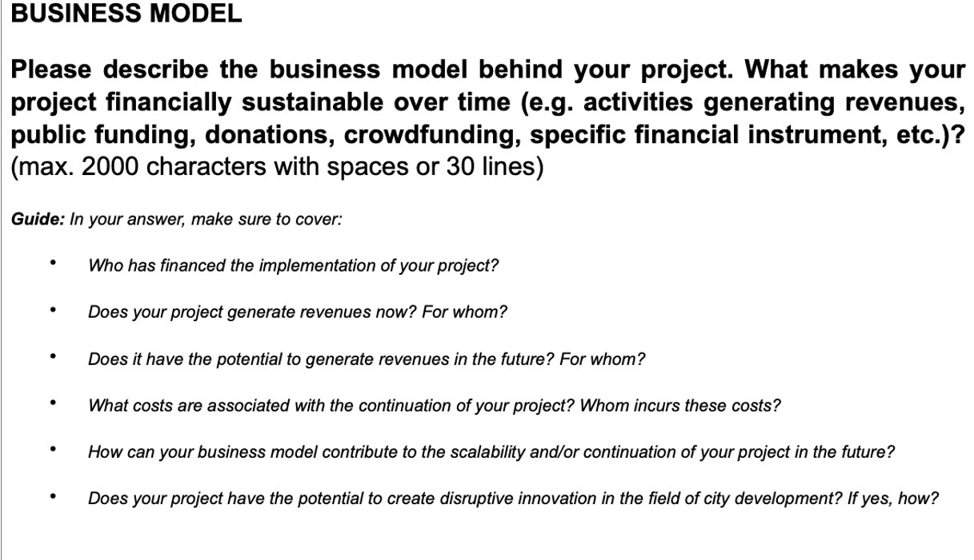
Question – Business Model
TIPS
short story about how the project's finances have evolved over time and how they are meant to evolve in the future.
longer explanation of how your business model contributes to the longevity of your project
short explanation of how your business model is innovative compared to similar projects

Slide 23
GOOD LUCK!
Send by 17th March 7pm

