Slide 1
NEB Prizes 2026
Application Bootcamp
Date 11th March 2026 – STRAND A – CHAMPIONS

Slide 2
4 CATEGORIES
Enhancing Circularity, Sustainability, and Innovation
Strengthening Local Democracy and Inclusion
Arts, Culture, and Heritage as Drivers of Change
Enablers for New European Bauhaus Transformation
1 SPECIAL PRIZE
Water Resilience
LINK TO DEFINITION OF THE 4 CATEGORIES and of WATER RESILIENCE
LINK TO ELIGIBILITY CRITERIA
INTERNATIONAL TRACK
Brazil
Japan

Slide 3
Place-based and beyond
The project you apply with can be...
A place-based project already executed in a specific location (e.g. a refurbished building)….
….but also
An innovative tool, material, design, method, learning approach, policy instrument, a governance model, a financial scheme, that has already been implemented in a given location/ market - and can enable physical, cultural and social transformation in line with the NEB values and working principles

Slide 4
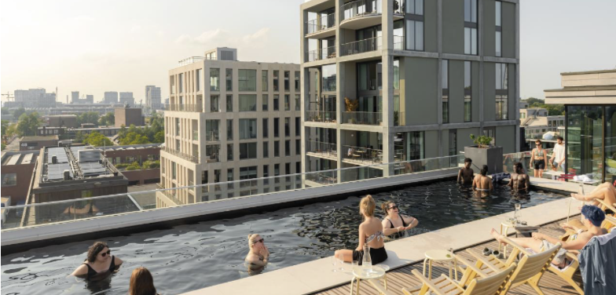
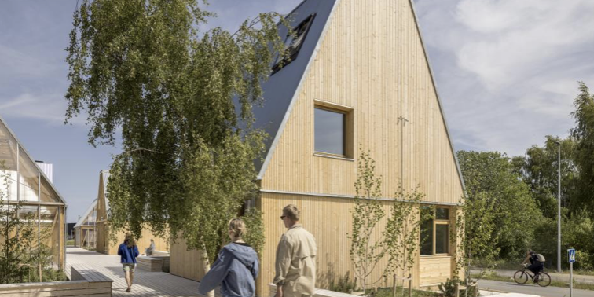
Examples – place-based and beyond
Republica, Amsterdam North
Living Places, Copenhagen

Slide 5
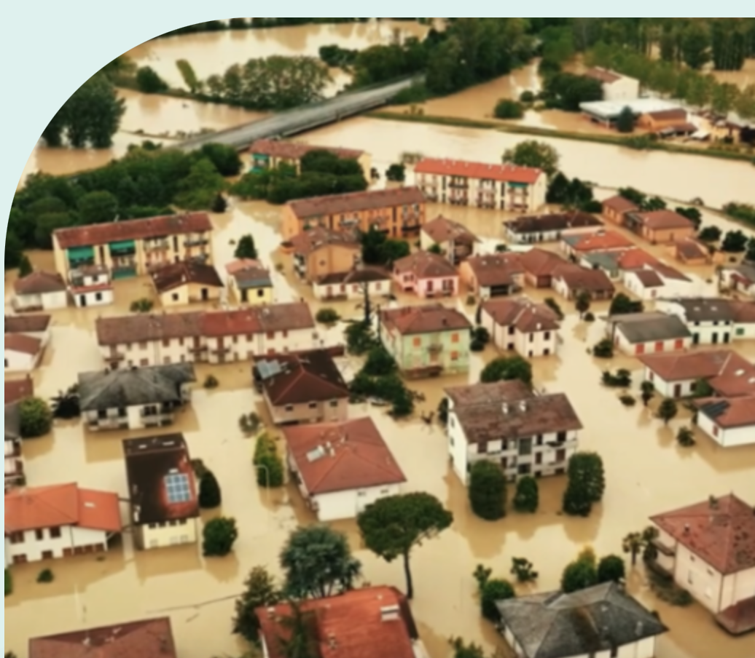
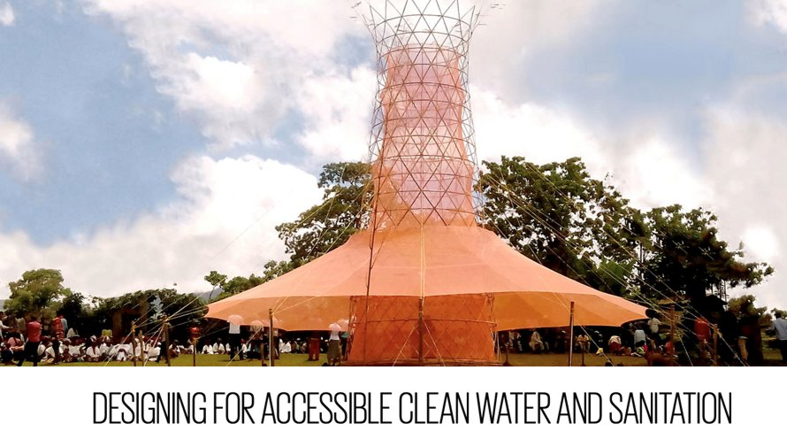
Water resilience - Examples
Place-based and beyond
Aqua Green, Faenza, Italy
Warka tower

Slide 6
OK,
READY TO START!

Slide 7
STRUCTURE OF THE APPLICATION FORM
I. PROJECT OVERVIEW | PROJECT TITLE & SHORT DESCRIPTION INFO (GEOGRAPHY, PARTNERS, APPLICANTS ETC...)
II. DETAILED DESCRIPTION | TELL US ABOUT YOUR PROJECT TELL US A STORY ABOUT YOUR PROJECT
III. ADHERENCE TO THE NEW EUROPEAN BAUHAUS | NEB VALUE: SISTAINABILITY NEB VALUE: AESTHETICS NEB VALUE: INCLUSION NEB WORKING PRINCIPLE: PARTICIPATORY NEB WORKING PRINCIPLE: MULTILEVEL GOVERNANCE NEB WORKING PRINCIPLE: TRANSDISCIPLINARY
IV. EU COMPETITIVENESS | BUSINESS MODEL SCALABILITY AND TRANSFERABILITY

Slide 8
TIPS TO ALWAYS KEEP IN MIND
BEFORE YOU START WRITING, FAMILIARISE WITH THE STRUCTURE AND THINK ABOUT WHAT YOU WANT TO COMMUNICATE – AND IN WHAT SECTION - TO AVOID REPETITION
WRITE A STORY HAVING THE RECEIVER IN MIND
PROVIDING CONCRETE EXAMPLES STRENGTHENS YOUR STORY TELLING
FOCUS ON RESULTS AND IMPACT MAKES YOUR PROJECT CONVINCING
USE DATA AND QUOTES FROM USERS OF YOUR PROJECT TO BACK UP YOUR CLAIMS
YOUR PROJECT IS NOT JUST A PROJECT – BUT AN EXAMPLE OF HOW TO REALISE THE CLEAN TRANSITION

Slide 9
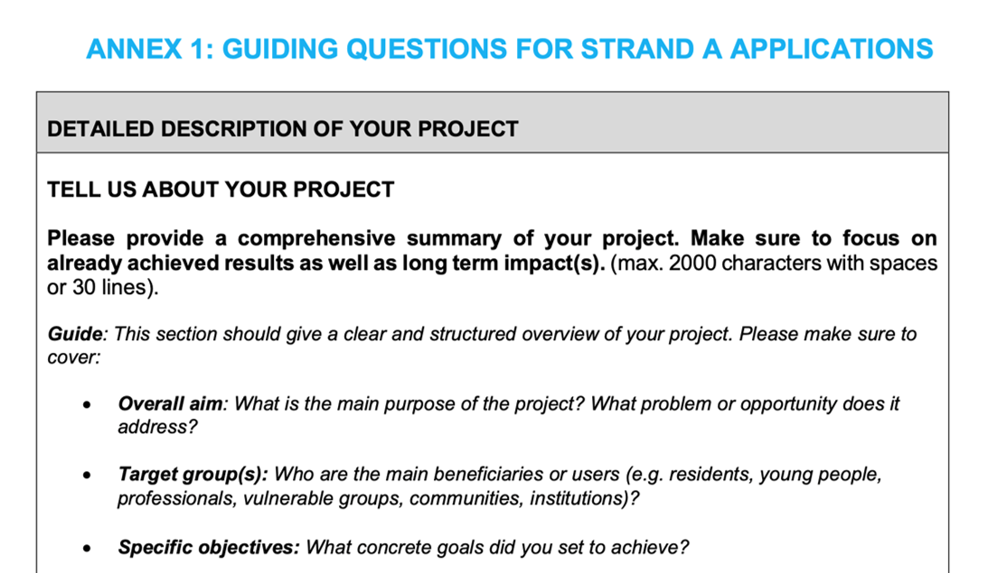
GUIDES TO APPLICANTS - ANNEX 1

Slide 10
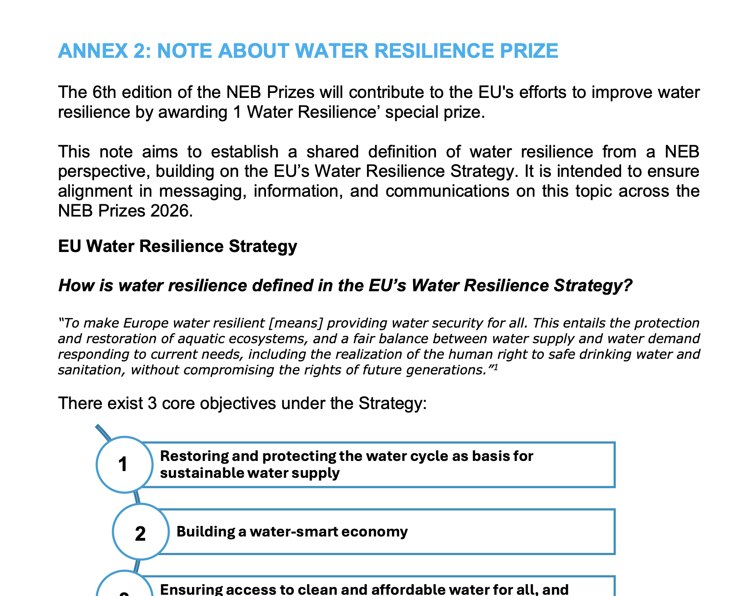
GUIDES TO APPLICANTS - ANNEX 2

Slide 11
I. SECTION – PROJECT OVERVIEW

Slide 12
Question – short & engaging description
TIP. write this text in a way that everybody can understand. Short and simple sentences, that get the reader curious.

Slide 13
II. SECTION – DETAILED DESCRIPTION

Slide 14
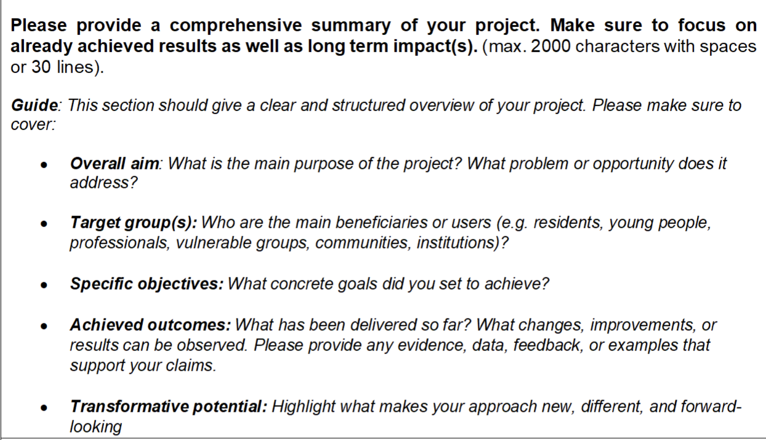
Question – Tell us about your project
TIPS:
A short description that allows the reader to picture your project in their head
A longer description of achieved results (that can be seen now)
A longer description of impacts (that will materialise soon or in the future based on current set up)

Slide 15
Answer from a previous winner
The Living Places partners VELUX, EFFEKT Architects, Artelia engineers, and Enemærke & Petersen contractors demonstrated with Living Places Copenhagen that we do not have to wait for future technologies to achieve an ultra-low carbon footprint and better indoor climate compared to the average Danish single-family house, but can already now create buildings that are affordable, scalable and commercially viable.
By challenging conventional norms and integrating affordability through design and innovative financial models, it seeks to provide adaptable, quality living spaces for the many.
Each material, design, and building technique for Living Places has been considered and mapped their projection for emissions against the typical Danish reference house. The total environmental impact of the building has been evaluated from the start through Life Cycle Assessments (LCA), a comprehensive framework for healthy living and better building practices that looks at both human wellbeing and the entire life cycle of a building, from design to construction to end of life.
The result is a single-family home, emitting only 3.85 kg CO2 eq/m2/year with third party verification from AAU BUILD - Department of the Built Environment.
The Living Places concept is based on five key principles, ensuring homes are healthy, adaptive, simple, shared over time and scalable. The project featured seven prototypes, including five open pavilions and two completed full-scale CLT and timber frame. Living Places advocates for an approach of democratisation, diversification, and acceleration of sustainable development through knowledge-sharing. The learnings from the project are widely accessible and are currently being implemented in different locations, contexts and configurations, to demonstrate the possibilities of the scalability principle.

Slide 16
III. SECTION – ADHERENCE TO THE NEB

Slide 17
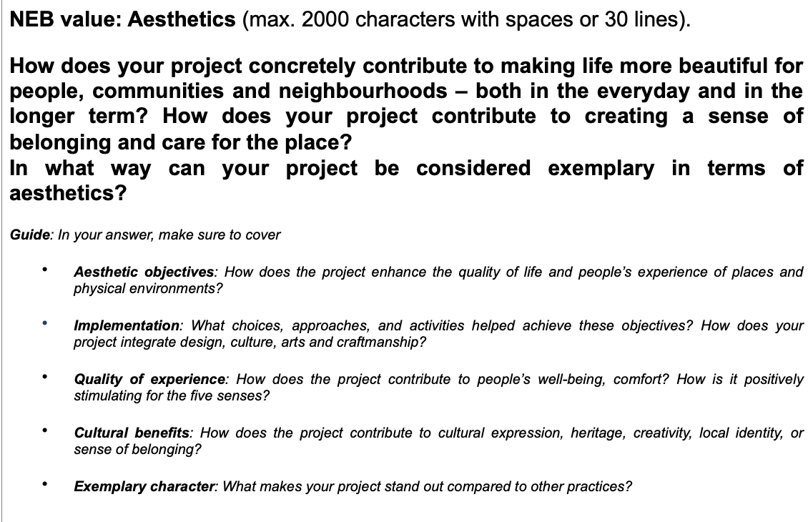
Question - Aesthetics
TIPS:
Aesthetics can feel fluffy – provide concrete examples to make the reader better understand your project
Evidence and data to back your claims up, and quotes from users and stakeholders of your project is a strength
Focus on one aspects of aesthetics at the time - from material to social and emotional

Slide 18
Answer from a previous winner
Promprylad is a unique example of how industrial heritage can be transformed into an aesthetically appealing and culturally vibrant space that enhances the quality of experience for people. The project preserves the authenticity of the former factory while integrating modern design elements that foster creativity, collaboration, and well-being.
The key aesthetic objective was to maintain the historical identity of the building while making it welcoming and functional. The design team carefully restored original industrial elements—exposed brick walls, steel structures, and large factory windows—blending them with contemporary architecture, sustainable materials, and open-plan spaces. This creates an atmosphere that is both inspiring and comfortable.
Another critical objective was to ensure a human-centered experience. The spaces are designed to encourage interaction, creativity, and productivity. Flexible layouts allow for different uses, from co-working and educational programs to cultural events and community gatherings. Natural light, greenery, and open areas enhance well-being and provide a connection to nature within an urban environment.
Art and culture play a central role in Promprylad’s transformation. The project hosts exhibitions, performances, and artistic interventions, making culture accessible and integrated into everyday life. Local artists contribute to the space’s identity, ensuring that it reflects the city’s creative pulse.
Promprylad is an exemplary case of how design can shape experiences, revive industrial heritage, and build a strong cultural identity. It serves as a model for rethinking urban spaces—not just as functional areas but as places that inspire, connect, and enrich communities.

Slide 19
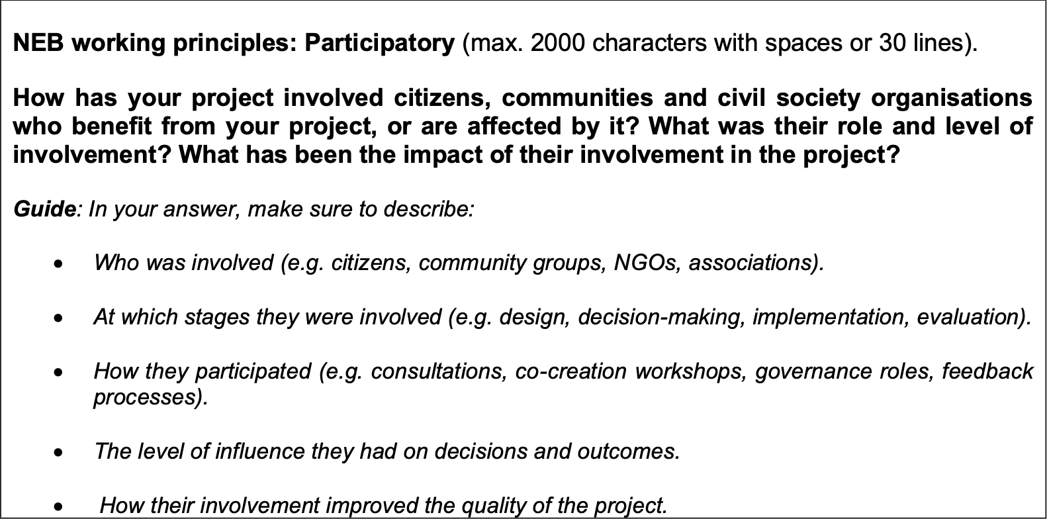
Question – Participatory
TIPS:
Describe how participation had a positive impact on the participants e.g. boosting their self-confidence, contributing to learning, creating agency and sense of care for the final product
Highlight the innovativeness of your participatory methods

Slide 20
Answer from a previous winner
Before starting the drafting of the project, the project's Promotional Group was created, made up of representatives of several associations and entities from the neighborhoods where the project is to be implemented and municipal technicians.
The Promotional Group is in charge of leading the project until its realization and of drafting together with the municipal technical team what is called 'Action Plan'. This is a document where the territorial diagnosis is made, and the improvements to be carried out are proposed with the aim of generating safer, more comfortable public spaces, with more social and sustainable uses, and with active mobility.
Subsequently and in parallel to the Driving Group during the process of developing the project of the 4 green axes and the 4 new squares of the Eixample, participation sessions were held to publicize and involve the neighbors in the project, and to receive information, comments, objections and proposals. All of them have been taken into account in the preparation of the Model Document and in the projects.
The participation process was deployed in various spaces and formats: through the Driving Group, sessions open to citizens, thematic spaces (with external specialists in the City Council), to jointly define a model of public space that would serve as a conceptual framework when applying specific solutions to each project area.
Sessions were also held in municipal spaces such as: “Climate Emergency Table of the Eixample District”, “the Table Against Air Pollution”, “Accessibility Working Group Accessibility and Independent Living Network (XAVI)”, “Barcelona + Sustainable Network”, “Eixample Women's Council”, “Eixample business entities”, or the “Mobility Pact”.
In total, more than 20 participatory actions were carried out, with more than 1,500 accumulated participants at the end of the process, which allowed the projects to be adapted and improved.

Slide 21
IV. SECTION – EU COMPETITIVENESS

Slide 22
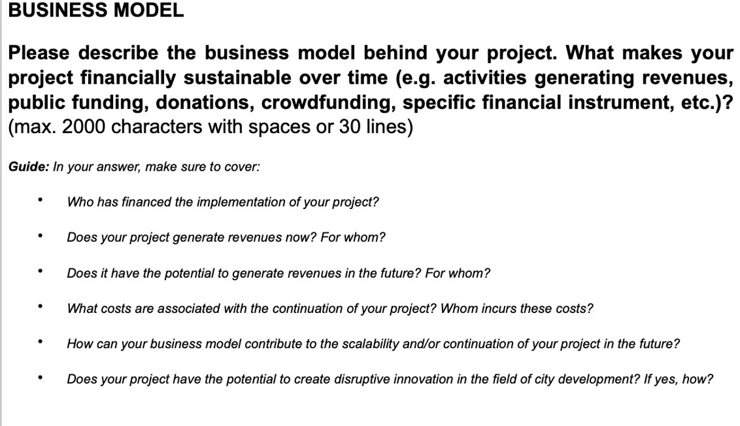
Question – Business Model
TIPS
short story about how the project's finances have evolved over time and how they are meant to evolve in the future.
longer explanation of how your business model contributes to the longevity of your project
short explanation of how your business model is innovative compared to similar projects

Slide 23
Example - a refurbished building used as a community space Our project has been financed/ will be financed by: 15% EU-funds, 20% municipality, 10% private donations from local companies, 50% national philantropic foundations.
Revenue structure: 5% yearly subsidies from the government because we employ chronically underemployed citizens in the kitchen and in the maintenance of our garden, 55% organisations renting our spaces – permanently or for events; 5% donation from local donors; 20% municipality's budget for culture; 10% specific projects; 5% consulting.
In the longer term we want to reduce our reliance on private rental for events and instead increase the percentage of private donations as well as of revenues from government-funded projects. This means higher expenditure on fundraising.
We are in the process of creating a fund, where profit generated every year is reinvested, and the local community will decide on what, through participatory budgeting. The project demonstrates a way of increasing the value of a building and creating an attractive destination for the entire town, while increasing living standards of local communities.

Slide 24
GOOD LUCK!
Send by 17th March 7pm

