Slide 1
NEB Prizes 2026
Information Session
3 March 2026
Notes:
good afternoon everyone,
Welcome to this information session on the New European Bauhaus Prizes 2026.
Thank you for joining us today to learn more about this year’s edition — the categories, the strands, the annual theme, and the application process.
This session will guide you through the key elements of the call and help you understand how your project or concept may fit within the New European Bauhaus framework.
To formally open the session, it is now my pleasure to give the floor to Alessandra from DG REGIO, who will introduce the 2026 edition of the NEB Prizes and its broader policy context.
Alessandra, the floor is yours.

Slide 2
Welcome
Notes:
Objectives of today’s session
Present the NEB vision and 2026 evolution
Explain the strands and categories
Walk you through the application process
Clarify evaluation criteria
Show available support tools

Slide 3
AGENDA
Introduction to NEB Prizes 2026
Eligibility criteria
Award criteria
Timeline
Useful tools
Q&A
Notes:
Let me briefly walk you through today’s agenda.
We will start with an introduction to the NEB Prizes 2026, including the structure of this year’s edition and what is new.
We will then move to the eligibility criteria — who can apply and what type of projects or concepts are eligible.
After that, we will explain the assessment criteria, so you understand how applications will be evaluated.
We will also present the timeline, including key deadlines and the different phases of the process.
Before concluding, we will highlight the useful tools and guidance documents available to support applicants.
And finally, we will open the floor for questions and answers.

Slide 4

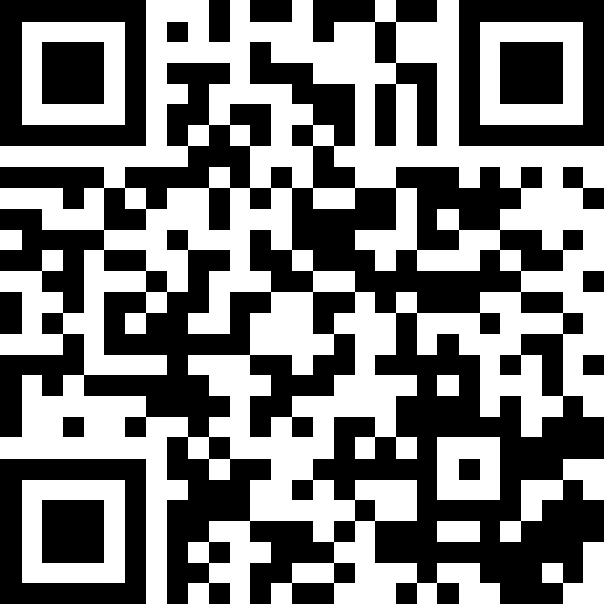
QR CODE
Please ask your questions throughout the presentation. We will take 30 minutes at the end to answer your questions.
Slido code: # 1848635
Notes:
Before we move forward, a quick note on questions.
Please feel free to submit your questions throughout the presentation using Slido. You can scan the QR code on the screen or enter the code displayed here.
We will collect your questions as we go, and we have reserved 30 minutes at the end of the session to address them.
This will allow us to provide clear and structured answers to as many questions as possible.

Slide 5
Introduction to NEB Prizes
QUESTIONS?
Slido code: # 1848635
Notes:
We will now move to the introduction to the New European Bauhaus Prizes 2026.
In this first part, the objective is to give you a clear understanding of what the NEB Prizes are, how they are structured this year, and what makes the 2026 edition distinctive.
And as a reminder, if questions arise during this section, please feel free to submit them via Slido using the QR code or the code displayed on the screen.
Let us begin.

Slide 6
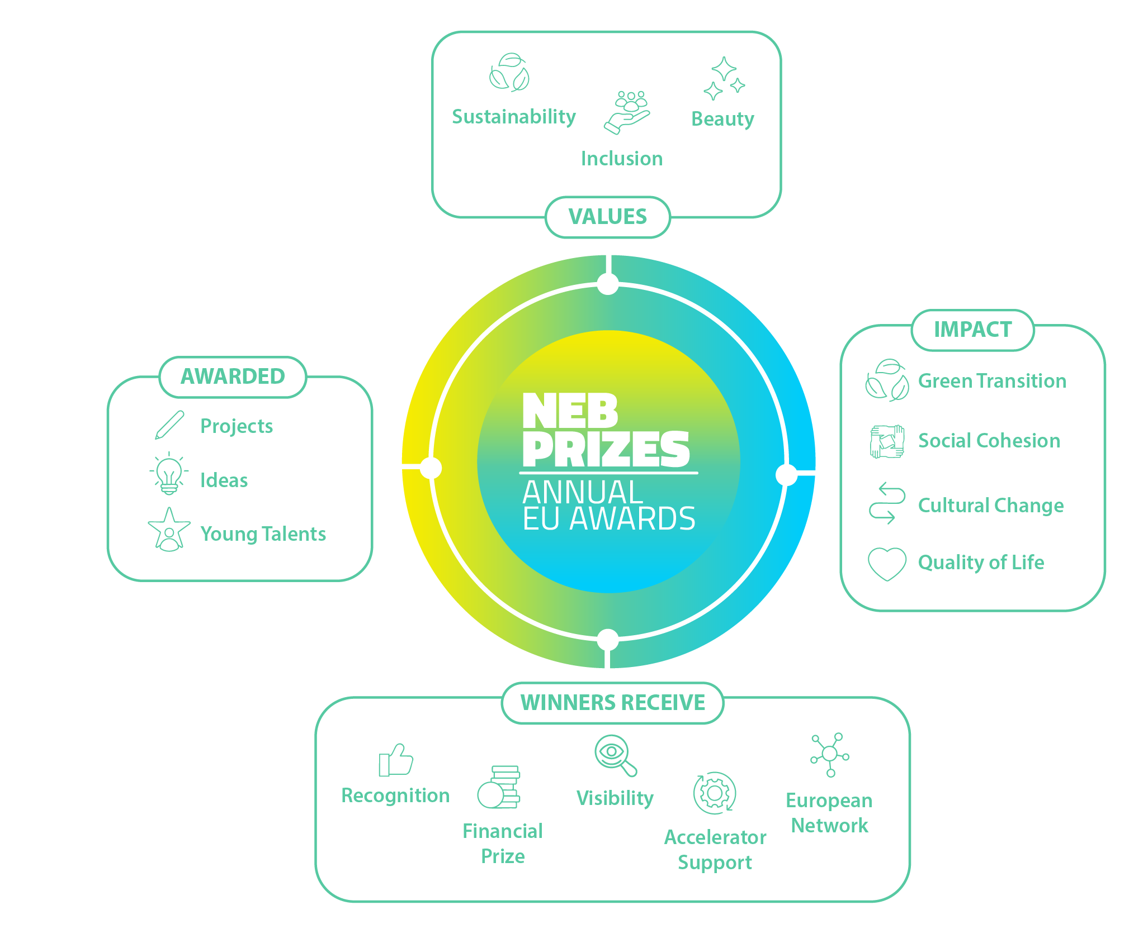
What are
the NEB Prizes?
STRAND A - Champions
STRAND B – Rising stars
Notes:
Script – “What are the NEB Prizes?”
Since 2021, the NEB Prizes are EU awards recognising projects, ideas and young talents that embody the three core NEB values: sustainability, inclusion and beauty.
These values are not separate. They must be combined. The initiative is about delivering environmental transformation while ensuring social fairness and high-quality design.
They celebrate concrete initiatives that:
Improve people’s quality of life
Contribute to the green transition
Strengthen social cohesion
Inspire change across Europe and beyond
There are two strands.
Strand A – Champions – recognises completed projects that already demonstrate impact on the ground.
Strand B – Rising Stars – recognises ideas and concepts developed by young talents, supporting the next generation of change-makers.
Beyond the values and strands, the prizes aim to generate impact. This includes contributing to the green transition, strengthening social cohesion, fostering cultural change, and ultimately improving quality of life across Europe.
Finally, winners receive more than financial support. They gain recognition, visibility at European level, and integration into the growing NEB community and network. Furthermore, and this will be a smooth transition to the next slide: in 2026, all finalists will benefit from an “accelerator” programme

Slide 7
What is new in the NEB Prizes 2026 edition?
Special prize: WATER RESILIENCE
International dimension: NEB Prizes in BRAZIL & JAPAN
Support to finalists: ACCELERATOR PROGRAMME
The Prizes welcome applications from MOLDOVA
Notes:
The 2026 edition introduces three developments.
First, the annual theme is Water Resilience. This responds to the growing urgency of climate adaptation, flood prevention, water scarcity and sustainable water management. Projects applying under this theme should demonstrate how they contribute to resilient water systems, while fully integrating the NEB values of sustainability, inclusion and beauty.
Second — and this is new in 2026 — the Prizes introduce an international dimension. For the first time, dedicated NEB Prizes will be awarded in Brazil and Japan. This marks an important step in extending the New European Bauhaus approach beyond the EU and strengthening global cooperation around sustainable and inclusive transformation.
Third, there is reinforced support to finalists through the Accelerator Programme: one coach will support each finalist to make their project visible and shine, as well as to prepare their venue to the Award ceremony in Brussels, to take the most out of it and navigate EU networks
Finally moldova

Slide 8
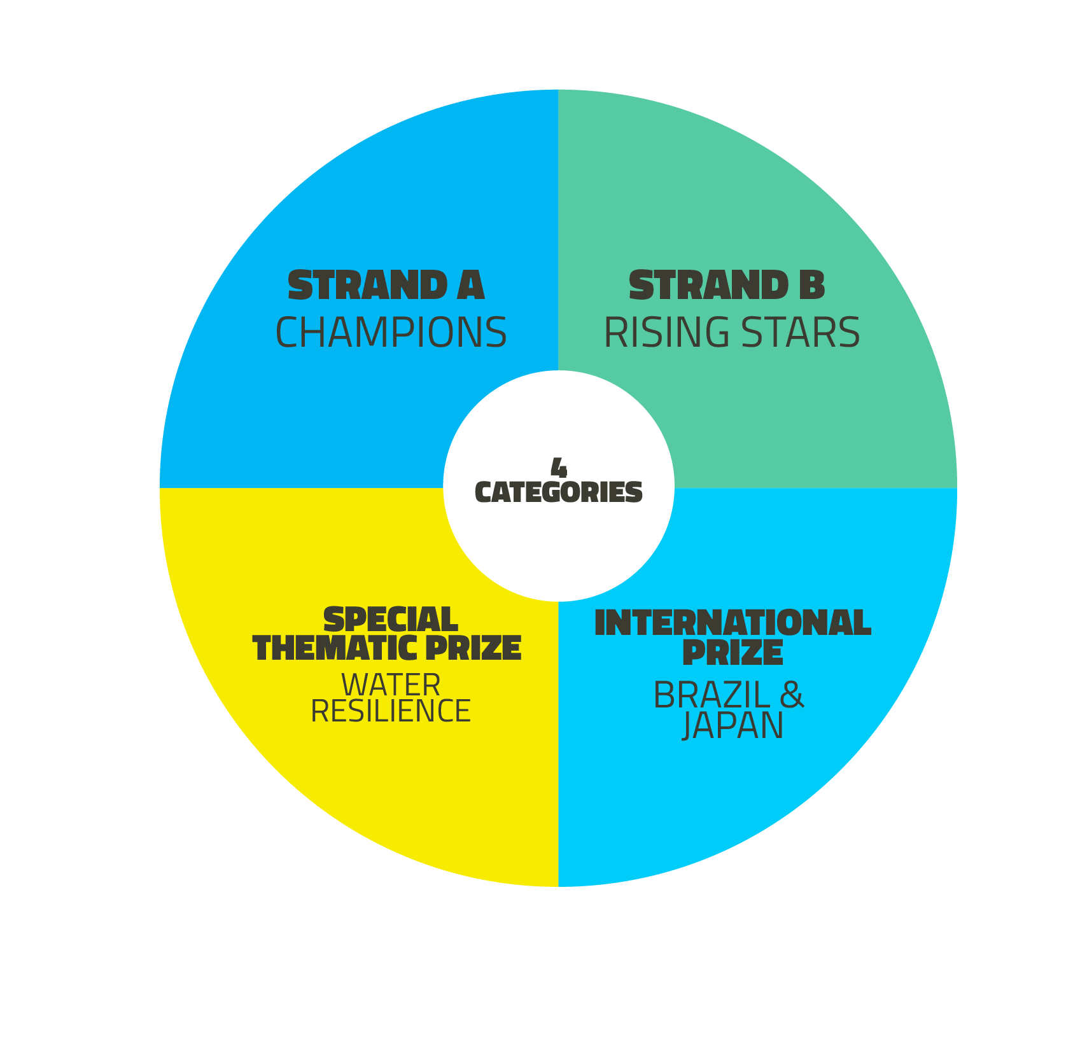
NEB Prizes 2026 edition at a glance
4 Category winners
20 000 € each
1 Public vote winner
20 000 €
4 Runners-up
5000 € each
4 Category winners
15 000 € each
1 Public vote winner
15 000 €
4 Runners-up
5000 € each
1 Winner
20 000 €
2 Runners-up
5000 € each
2 Winners
20 000 € each
4 Runners-up
5000 € each
Notes:
The Prizes are organised around four categories, which apply across the different strands. We’ll come back to them
In Strand A – Champions, we award:
Four category winners, each receiving €20,000,
One public vote winner, also receiving €20,000,
And four runners-up, each receiving €5,000.
In Strand B – Rising Stars, the structure is similar:
Four category winners receive €15,000 each,
One public vote winner receives €15,000,
And four runners-up receive €5,000 each.
In addition, we have the Special Prize on Water Resilience, which includes:
One winner receiving €20,000,
And two runners-up receiving €5,000 each.
Finally, the new International Prize, awarded in Brazil and Japan, includes:
Two winners receiving €20,000 each,
And four runners-up receiving €5,000 each.
This structure ensures both recognition of excellence and broad visibility across categories, generations and geographies.

Slide 9
What type of projects or concepts?
The project or concept integrates and promotes the NEB values and working principles, and improves - or aims to improve - the quality of life for people and communities in the long term.
Each application must be related to a specific location or region, with a clear target group and defined objectives.
Projects or concepts that cannot be replicated in other contexts are not eligible.
Notes:
Now, what type of projects or concepts are eligible.
First, the project or concept must clearly integrate and promote the New European Bauhaus values and working principles. It should contribute — or aim to contribute — to improving the quality of life for people and communities in the long term.
Second, each application must be linked to a specific location or region. Applications need to demonstrate a clearly identified territory, a defined target group, and concrete objectives.
Third, projects or concepts must demonstrate potential for replication. Initiatives that are too context-specific and cannot be adapted or transferred to other settings are not eligible.
In summary, eligible initiatives must be place-based, value-driven, and capable of scaling or inspiring broader application.
Beyond these formal eligibility requirements, the ambition of the New European Bauhaus is transformative.
The Prizes recognise initiatives that do not merely address a challenge, but that reshape how places function and how people experience them. They aim to demonstrate how sustainability can be inclusive, how inclusion can be beautiful, and how beauty can support long-term environmental and social transition.
It is important to underline that the NEB Prizes are not limited to architecture. They recognise projects, services, cultural initiatives, governance models, and business innovations that embody the NEB values.
The New European Bauhaus seeks to make the green transition tangible in everyday life. Projects that make this transformation visible, concrete and replicable are at the heart of the initiative.

Slide 10

The 4 Prize Categories
Enhancing Circularity, Sustainability, and Innovation
Notes:
The first category focuses on projects that combine beauty, sustainability, and social inclusion through circular and resource-efficient approaches.
It recognises solutions that reduce environmental impact while improving quality of life, affordability, and resilience, across sectors such as construction, textiles, furniture, and design.
Eligible projects are expected to apply circular principles — including reuse, repair, modularity, design for disassembly, sharing models, and the use of bio-based or recycled materials — and to reinforce local or regional circular value chains.
In the built environment, this may include renovation, repurposing, temporary uses, or smarter use of space and infrastructure to address housing and space constraints.
Projects may also integrate energy-, water-, and material-efficient strategies, nature-based solutions, and digital or AI tools contributing to climate action, biodiversity protection, and sustainable resource management.
More broadly, the category recognises technological, social, and community-led innovation that can be replicated or scaled up, including new spatial, organisational, and business models supporting SMEs, skills development, and climate-neutral, nature-positive futures.
Affordability and social inclusion must be embedded throughout.

Slide 11

The 4 Prize Categories
Enhancing Circularity, Sustainability, and Innovation
Strengthening Local Democracy and Inclusion
Notes:
The second category recognises projects that strengthen local democracy, social cohesion, and trust by placing citizens at the centre of decision-making and implementation.
Projects must demonstrate genuine participatory and co-design approaches, bringing together citizens, professionals, and public authorities in transdisciplinary collaboration.
The use of innovative tools — including digital platforms and immersive environments — to support participation and collective decision-making is encouraged.
Co-ownership, cooperative, and community-led models promoting affordability and inclusion are particularly welcome.
This category also rewards initiatives that create inclusive, accessible, high-quality public spaces and neighbourhoods, fostering belonging and intergenerational fairness.
Projects may address the needs of vulnerable groups, including people at risk of exclusion, poverty, homelessness, or displacement.
Applications may also demonstrate “design for all” principles and innovative governance or business models, such as cooperative schemes, anti-speculation mechanisms, or impact investment.
The overall objective is to reinforce resilient social structures and stronger democratic practices rooted in everyday life.

Slide 12

The 4 Prize Categories
Enhancing Circularity, Sustainability, and Innovation
Strengthening Local Democracy and Inclusion
Arts, Culture, and Heritage as Drivers of Change
Notes:
This category recognises the role of arts, culture, and cultural heritage as drivers of creativity, innovation, and social transformation within the NEB framework.
It welcomes transdisciplinary initiatives connecting art, science, and industry — for example, by embedding artists in technological or scientific environments, or by fostering collaboration with construction, manufacturing, and academic sectors.
Projects may combine cultural and vernacular knowledge with digital and emerging technologies to enhance participation and learning.
They may also involve the transformation of places, showing how new, renovated, or repurposed spaces connect heritage with contemporary lifestyles and demographic realities.
Adaptive reuse of heritage buildings, based on repair and informed renovation, is particularly encouraged as a contribution to decarbonisation while preserving cultural value.
Examples may include products, services, or business models rooted in local culture and craftsmanship in areas such as fashion, furniture, design, food, and everyday living.

Slide 13

The 4 Prize Categories
Enhancing Circularity, Sustainability, and Innovation
Strengthening Local Democracy and Inclusion
Arts, Culture, and Heritage as Drivers of Change
Enablers for New European Bauhaus Transformation
Notes:
The fourth category focuses on initiatives that create the conditions necessary to develop, scale up, and mainstream NEB solutions.
It rewards projects that support new ways of working, learning, governing, and financing sustainable and inclusive transformation.
This includes innovative governance and participation models, funding schemes, education and skills programmes, and experimental environments where NEB approaches can be tested and refined.
Projects may promote good practices to attract private investment and develop innovative financing mechanisms, such as blended finance, local funding instruments, public–private partnerships, or cooperative schemes.
Eligible initiatives may also support the development of NEB-aligned standards, peer-learning platforms, professional training, technical assistance, and specialised academic programmes.
Particular attention is given to initiatives that empower local actors, foster cross-sector collaboration, and support communities in co-creating their living environments.

Slide 14
Eligibility criteria
The following slides provide a high-level overview of the eligibility criteria. The full and legally binding eligibility conditions are set out in the official guidance documents
QUESTIONS?
Slido code: # 1848635
Notes:
The following slides provide a high-level overview of the eligibility criteria. They are intended to guide applicants through the main conditions and requirements.
However, the full and legally binding eligibility criteria are set out in the official guidance documents. In case of any discrepancy, the official call documentation prevails.
Applicants are therefore strongly encouraged to consult the complete guidance carefully when preparing their submission.

Slide 15
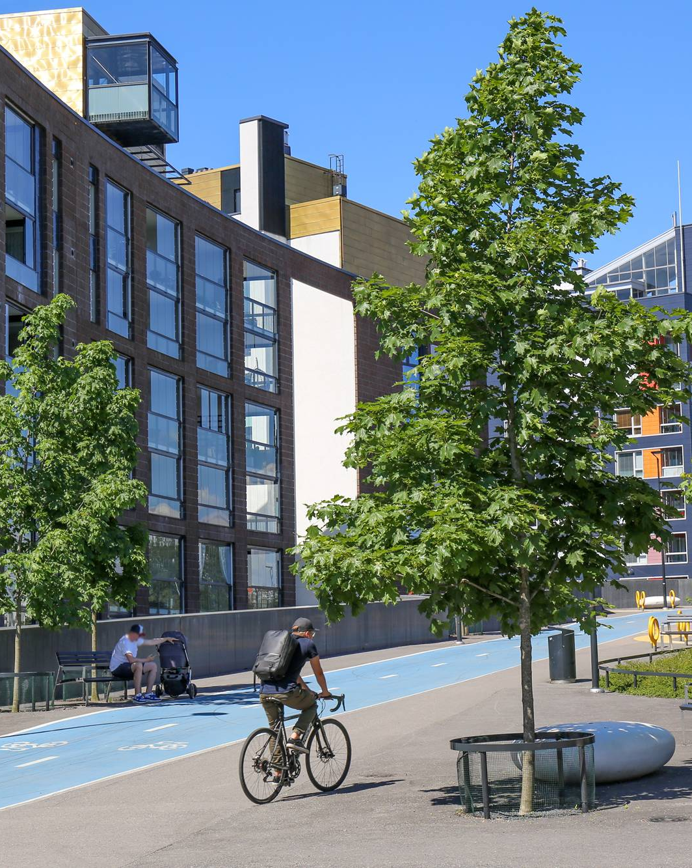
STRAND A - Champions
Strand A awards existing, completed projects that are already implemented and can show positive results.
Notes:
Let us begin with Strand A – Champions.
Strand A recognises existing and completed projects that have already been implemented.
This means the project must be finalised and able to demonstrate concrete and positive results on the ground.
Applications under this strand should provide evidence of impact — whether environmental, social, cultural, or economic — in line with the New European Bauhaus values.

Slide 16
STRAND A - Champions
Who can apply?
Applicants can be an individual, a public authority, a non-profit organisation, or a private entity representing an existing or completed project.
Applicants can be EU or non-EU residents, if their projects are implemented in the EU, in the Western Balkans, Moldova, or in Ukraine.
Applicants are not eligible if they have received a monetary EU prize. However, projects that have previously received public funding, including from the EU, (e.g. a grant) are eligible, so long that they have not won a monetary EU prize.
Notes:
Under Strand A – Champions, a wide range of applicants can apply.
Applicants may be individuals, public authorities, non-profit organisations, or private entities, provided they are representing an existing and completed project.
Regarding geographic eligibility, applicants may be EU or non-EU residents, as long as the project has been implemented in the European Union, in the Western Balkans, in Moldova, or in Ukraine.
There is also an important clarification regarding previous EU funding.
Applicants are not eligible if they have already received a monetary EU prize
However, projects that have received public funding — including EU grants — remain eligible, provided they have not previously won a monetary EU prize.

Slide 17
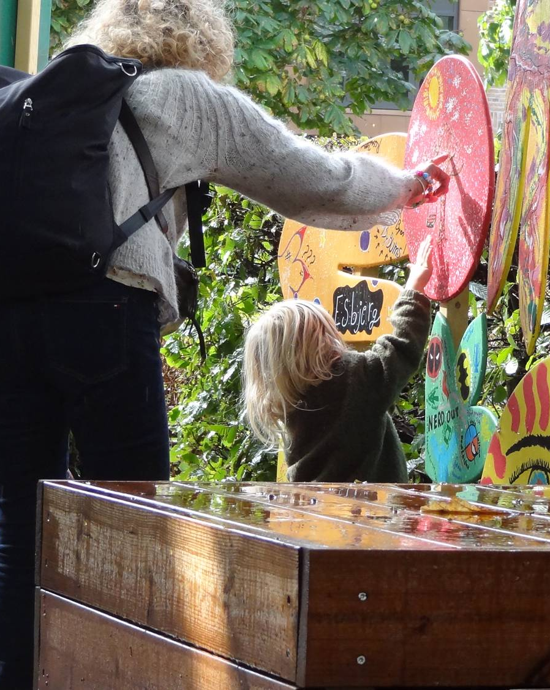
STRAND B –
Rising Stars
Strand B rewards promising concepts and early-stage initiatives developed by young and promising talents (from ideas to prototypes) that are not necessarily completed yet but show strong potential and a clear plan to be brought to life.
Notes:
We now move to Strand B – Rising Stars.
Strand B recognises promising concepts and early-stage initiatives developed by young and emerging talents.
Unlike Strand A, projects under Strand B do not need to be completed. They may range from well-developed ideas to prototypes.
What is essential is that the concept demonstrates strong potential, clear alignment with the New European Bauhaus values, and a credible plan for implementation.

Slide 18
STRAND B – Rising Stars
Who can apply?
Applicants must be 30 years old or younger on the final day of the call for applications, including all representatives of the organisation involved in the creation of the given concept.
Applicants can be an individual or organisation (public, private, or non-profit) that has developed promising concepts and early-stage initiatives.
Applicants can be EU or non-EU residents, if their projects are implemented in the EU, in the Western Balkans, Moldova, or in Ukraine.
Notes:
Under Strand B – Rising Stars, specific eligibility conditions apply.
Applicants must be 30 years old or younger on the final day of the call for applications. This age requirement applies to all representatives involved in the creation of the concept.
Applicants may apply either as individuals or as organisations — whether public, private, or non-profit — provided they have developed a promising concept or early-stage initiative.
As with Strand A, applicants may be EU or non-EU residents, as long as the project is to be implemented in the European Union, in the Western Balkans, in Moldova, or in Ukraine.

Slide 19
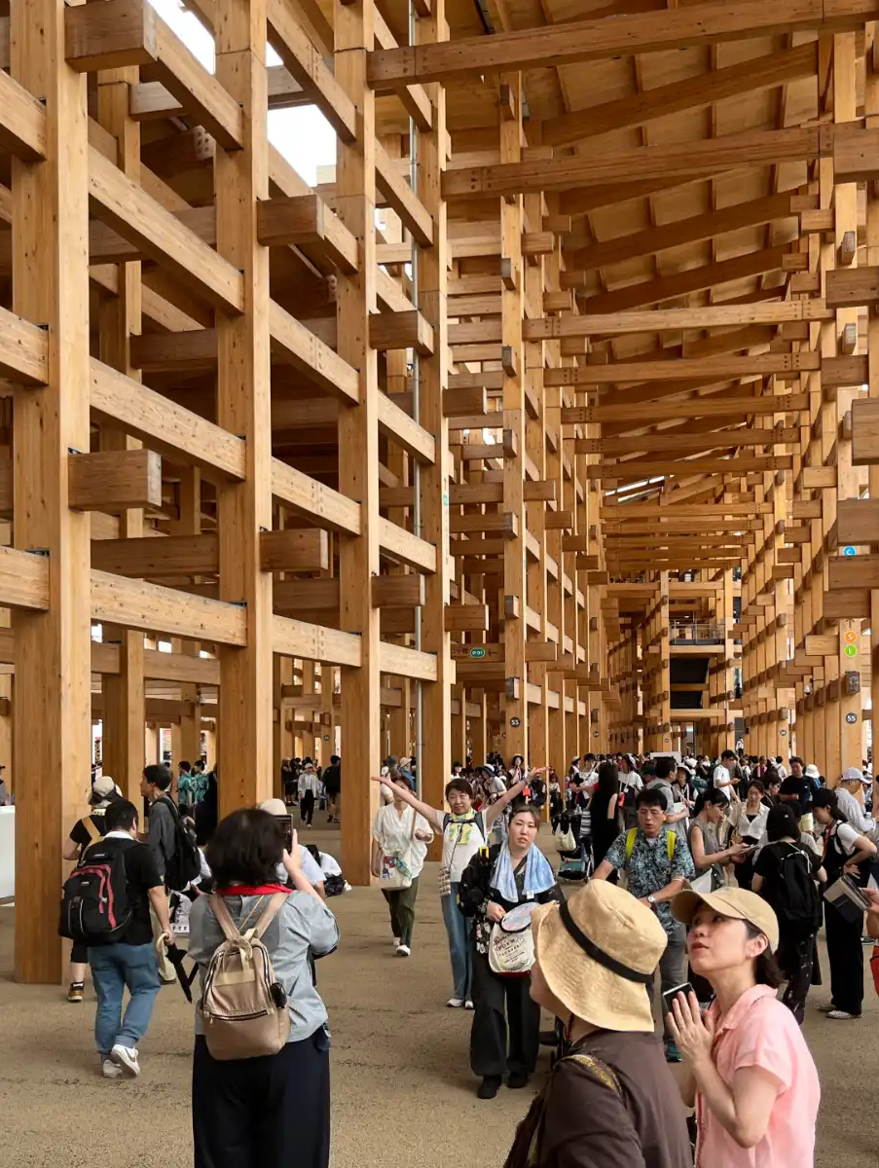
INTERNATIONAL PRIZES –
Brazil & Japan
The 2026 edition of the NEB Prizes will reward and celebrate Brazilian and Japanese existing projects (Strand A)
and ideas from young people (Strand B)
that embody the New European Bauhaus values (sustainable, inclusive, beautiful) and its working principles: a participatory process, multi-level engagement, and a transdisciplinary approach.
Notes:
The 2026 edition of the NEB Prizes introduces an international dimension.
the Prizes will recognise projects in Brazil and Japan.
It may be existing and completed projects from these countries may be awarded.
Or ideas and early-stage concepts developed by young talents may also be recognised.

Slide 20
INTERNATIONAL PRIZES – Brazil & Japan
Who can apply?
Applicants for Strand A and Strand B may be individuals, public authorities, non-profit organisations, or private entities that are nationals of, legally established in, and operating in Brazil or Japan, and that represent an existing and completed project implemented exclusively in the same country.
In addition, for Strand B : applicants in this strand, including any co-authors involved in the creation of the given concept, must be 30 years old or younger on the final day of call for applications.
Notes:
Let us now clarify who can apply for the International Prizes.
For both Strand A and Strand B, applicants may be individuals, public authorities, non-profit organisations, or private entities that are nationals of, legally established in, and operating in Brazil or Japan.
The project must be implemented exclusively in the same country.
For Strand B, the age requirement also applies. All applicants, including any co-authors involved in the creation of the concept, must be 30 years old or younger on the final day of the call for applications.

Slide 21
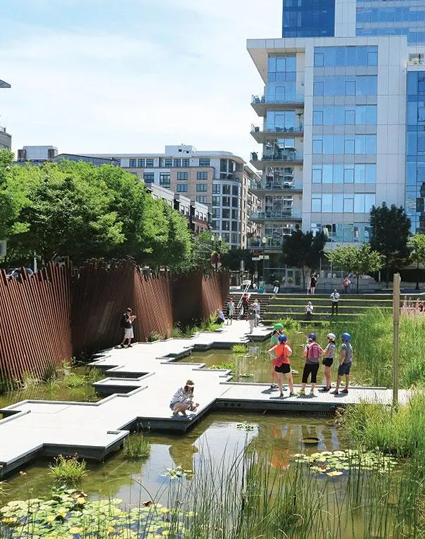
SPECIAL THEMATIC PRIZE–
Water Resilience
The 2026 edition of the NEB Prizes will reward and celebrate
existing projects (Strand A)
and ideas from young people (Strand B) that address challenges related to water resilience : from climate adaptation and sustainable water management to community preparedness.
Notes:
In addition to the main categories, the 2026 edition includes a Special Thematic Prize dedicated to Water Resilience.
This prize recognises both existing and completed projects under Strand A, and ideas developed by young people under Strand B, that address challenges related to water resilience.
This may include initiatives focused on climate adaptation, sustainable water management, flood and drought prevention, nature-based solutions, or community preparedness.

Slide 22
THEMATIC PRIZE– Water Resilience
Who can apply?
Applicants for Strand A and Strand B if they state they want to apply to the Special Prize
Notes:
The Water Resilience special prize is not a separate application track.
Applicants do not apply directly to a dedicated Water Resilience category.
Instead, EU projects or concepts applying under any of the four main categories, and under either Strand A or Strand B, may be considered for the Water Resilience prize if they clearly address water resilience challenges.
To be eligible for the special prize, the application must clearly explain how it contributes to water resilience, while fully integrating the NEB values of sustainability, inclusion and beauty.
Apllicant should also tick the dedicated box in the application form to be considered

Slide 23
Award criteria
QUESTIONS?
Slido code: # 1848635
Notes:
Now let us turn to the award criteria.
All applications are assessed against a set of common criteria that reflect the core values and principles of the New European Bauhaus.
Projects are evaluated not only on what they aim to achieve, but also on how they embody sustainability, inclusion and aesthetics — and how convincingly they demonstrate impact and quality.
The evaluation process is carried out by independent experts, ensuring fairness, transparency and consistency across all strands.
In the next slides, we will go through the criteria in more detail

Slide 24
Award Criteria
The quality assessment of applications will be conducted by external, independent experts based on the following award criteria :
Results, outputs, or impact (10 / 100 points)
Exemplary character in the 3 core values of NEB (40 / 100 points)
Exemplary character in the 3 main working principles of NEB (35 / 100 points)
Innovative dimension (5 / 100 points)
EU Competitiveness (5 / 100 points)
High potential for transferability (5 / 100 points).
Notes:
The quality assessment of applications will be conducted by external, independent experts, on the basis of the award criteria outlined here.
A maximum of 100 points will be awarded for the quality of the application. To be considered eligible for selection, an application must obtain at least 50% of the maximum aggregate score across all award criteria.
The first criterion concerns results, outputs, or impact, worth 10 points. Applicants must demonstrate the results of the project in relation to its objectives and what is expected in the respective category. This includes benefits for both direct and indirect beneficiaries. The project should also demonstrate its transformative potential from a global perspective.
The second criterion concerns the exemplary character in terms of the three core values of the New European Bauhaus, worth 40 points.
Sustainability refers to environmental sustainability. This includes, for example, reducing environmental impact, advancing circularity and eco-design, implementing nature-based solutions, preventing biodiversity loss, and promoting economic activities that encourage preservation, regeneration, and lifecycle thinking. Social and financial sustainability are not part of this criterion.
Inclusion refers to accessibility and affordability for all, inclusive management, and design for all. It includes celebrating diversity, promoting interaction across generations, addressing spatial segregation and isolation, supporting vulnerable members of the community, and increasing opportunities for social interaction.
Aesthetics and quality of experience for people refers to design and emotional or cultural benefits. This may include connecting to the unique qualities of the place, fostering a sense of belonging, and integrating enduring cultural and social values.
The third criterion concerns the exemplary character in terms of the three main working principles of the New European Bauhaus, worth 35 points.
The participatory process refers to the involvement of communities potentially affected by the project in co-design, decision-making and implementation, as well as the empowerment of local communities.
Multi-level engagement refers to effective exchange both horizontally, between citizens, stakeholders or municipalities, and vertically, with regional and/or national stakeholders.
The transdisciplinary approach refers to the engagement of professionals and knowledge from different fields, as well as drawing on the knowledge of non-academics and the public.
The innovative dimension, worth 5 points, assesses whether the project demonstrates novel approaches compared to mainstream, business-as-usual practices.
EU competitiveness, also worth 5 points, assesses the soundness of the financial approach to the project.
High potential for transferability and replication, worth 5 points, assesses whether parts of the project, such as methodology, solutions or experiences, can be transferred to different places and contexts.
Following the ranking of applications based on these criteria, the jury’s final proposal will also take into account geographical diversity, balance between hard and soft investments, and diversity of contexts, including urban, rural and urban–rural linkages.
The final ranking and selection of winners will be confirmed by the Evaluation Committee, composed of Members of the European Commission. This Committee holds full responsibility for ensuring the proper conduct of the competition and its final outcomes.

Slide 25
Additional Criteria
Considering the ranking of applications based on the award criteria listed above, the final proposal by the jury will also consider the following additional criteria:
Geographical diversity
Balance between applications referring to physical transformation of the built environment (‘hard investments’) and other types of transformations (‘soft investments’)
Diversity of contexts (urban, rural, urban-rural linkages)
Notes:
In addition to the ranking based on the award criteria, the final proposal by the jury will also take into account a number of additional considerations.
First, geographical diversity.
Second, a balance between applications referring to physical transformation of the built environment — so-called hard investments — and other types of transformations, referred to as soft investments.
Third, diversity of contexts, including urban areas, rural areas, and urban–rural linkages.
These elements are considered when formulating the final proposal for the winners among the shortlisted finalists.

Slide 26
Timeline
QUESTIONS?
Slido code: # 1848635
Notes:
Let us now turn to the timeline of the 2026 edition of the New European Bauhaus Prizes.

Slide 27
Timeline
ACCELERATOR PROGRAMME
For finalists in the EU
CALL OPEN PERIOD
Launch: 20 February 2026
Deadline: 17 March 2026
ANOUCEMENT OF FINALISTS & PUBLIC VOTING
June-July
ANOUCEMENT OF WINNERS
Award ceremony (autumn 2026)
SELECTION
April-May
Notes:
The call opened on 20 February 2026 and will close on 17 March 2026.
Applications must be submitted before the deadline indicated in the call documentation.
Following the closure of the call, eligibility checks will be carried out to verify compliance with the conditions of the competition.
The selection phase will take place in April and May. During this period, the quality assessment will be conducted by external, independent experts, in line with the award criteria.
In June and July, the finalists will be announced and the public voting phase will take place.
The jury will then formulate its proposal for the winners.
The winners will be officially announced at the award ceremony in autumn 2026.
An Accelerator Programme will also be offered to finalists in the European Union.

Slide 28
Useful tools
QUESTIONS?
Slido code: # 1848635
Notes:
Let us now present the useful tools available to support applicants.

Slide 29
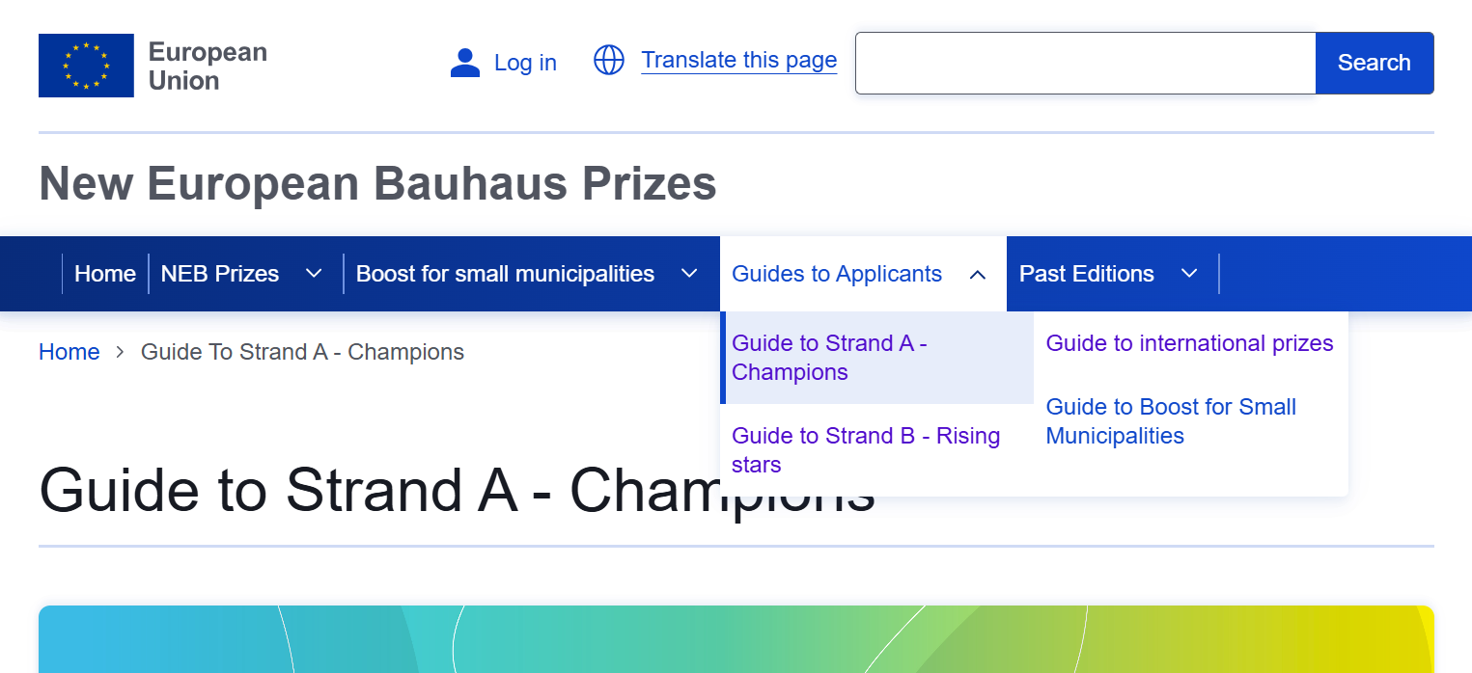
Guides to applicants
On the NEB Prizes webpage, you can find guides to applicants for each prize https://prizes.new-european-bauhaus.europa.eu/
Notes:
Here is a script strictly aligned with what appears on the slide and framed in an institutional tone:
On the New European Bauhaus Prizes webpage, you can find dedicated Guides to Applicants for each prize.
These guides are available at: prizes.new-european-bauhaus.europa.eu.
Separate guides are provided for Strand A – Champions, Strand B – Rising Stars, the International Prizes, and the Boost for Small Municipalities.
Applicants are strongly encouraged to consult the relevant guide carefully before preparing and submitting their application.
The guides provide detailed information on eligibility conditions, award criteria, submission requirements and the evaluation process.
They are the primary reference documents for the call.

Slide 30
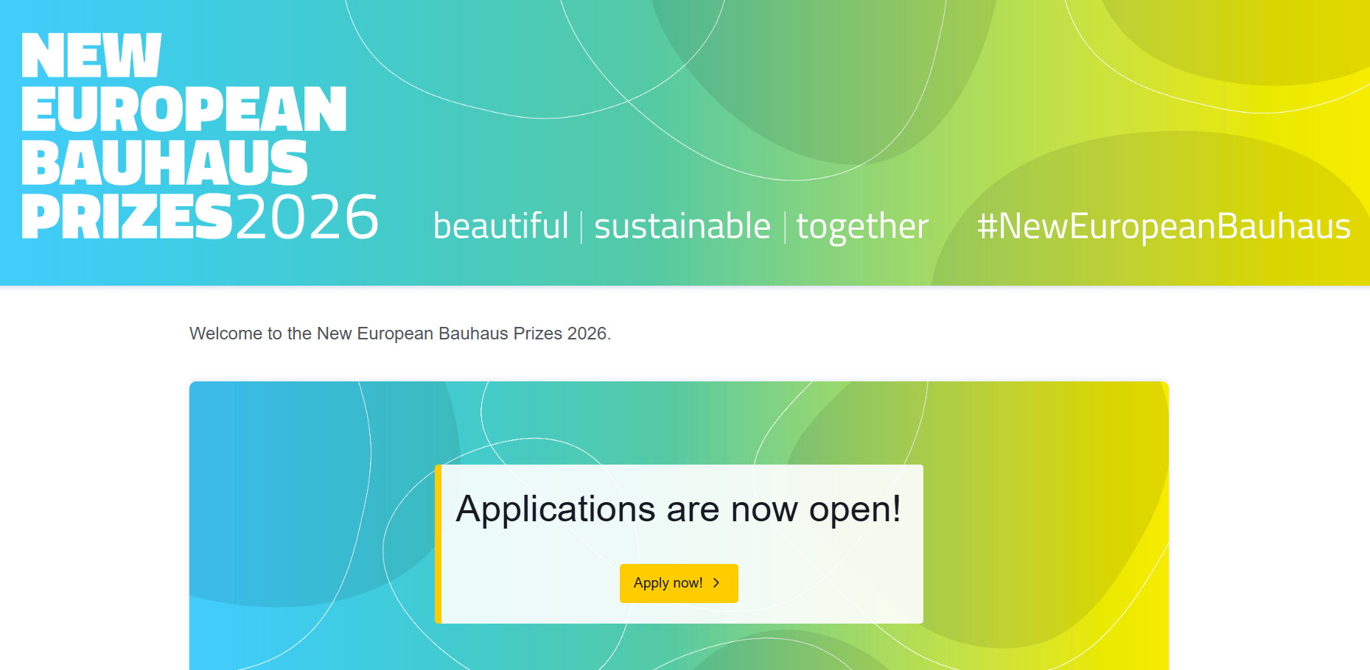
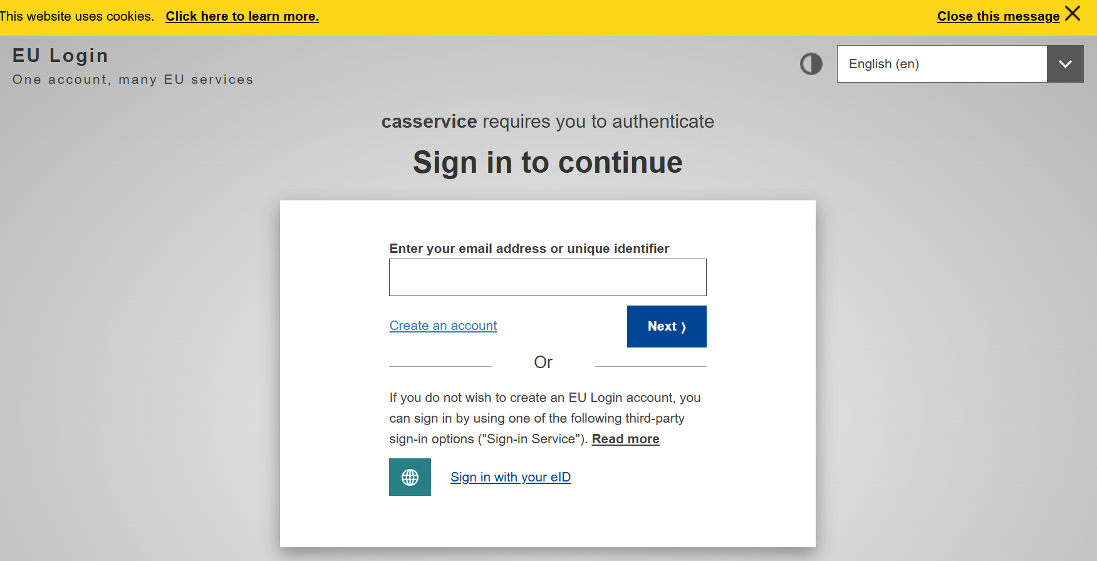
Online Application Form
Your application must be submitted online. Use the « Apply now » button on the home page of the NEB Prizes website
You will be redirected to the online platform to fill in the application form
Notes:
(you may have to create an ccount if you don’t have one already

Slide 31
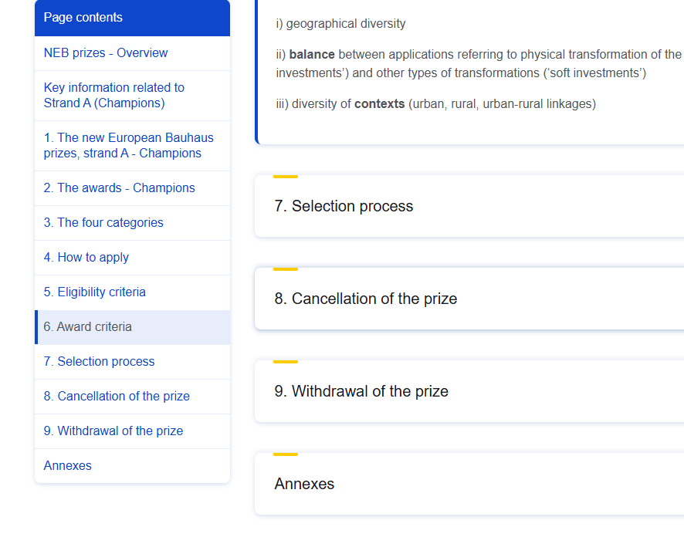
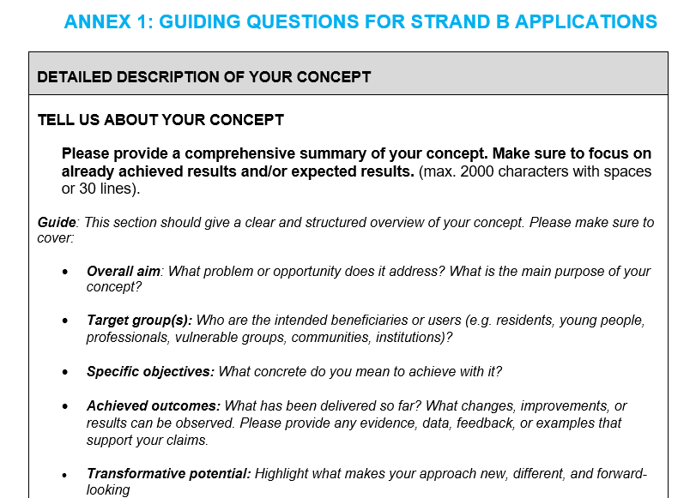
Guiding questions to fill in the application
In the Annex of each guide, you will find guiding questions to help you through the application process:
On Wednesday 11th of March from 1 to 3PM CET, we will hold an NEB Bootcamp to deep dive into these guiding questions
Notes:
In the Annex of each Guide to Applicants, you will find guiding questions to support you in completing the application form.
These questions are designed to help applicants structure their responses and ensure that all required elements are addressed in a clear and comprehensive manner.
They cover the detailed description of your concept, including the overall aim, target groups, specific objectives, achieved outcomes, and transformative potential.
Applicants are strongly encouraged to consult these guiding questions carefully when preparing their submission.
In addition, on Wednesday 11 March, from 1 to 3 PM CET, we will organise an NEB Bootcamp to provide a deep dive into these guiding questions and support applicants in understanding how to approach them.

Slide 32
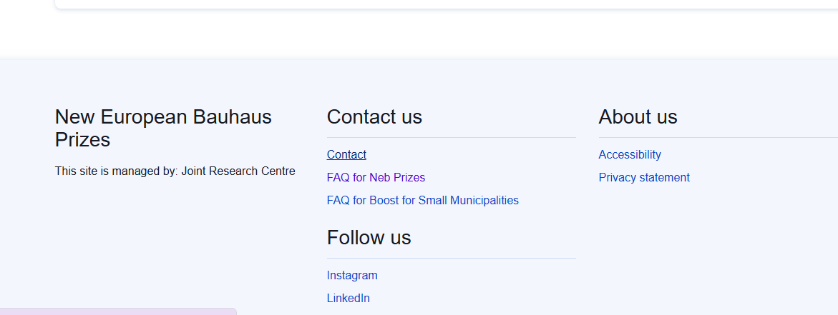
Other existing resources
On the New European Bauhaus general page https://new-european-bauhaus.europa.eu/tools-and-resources_en
NEB compass, which outlines the values and working principles of the initiative and illustrates diverse levels of ambition
NEB checklist to test the coherence of your application.
on the NEB Prizes website: https://prizes.new-european-bauhaus.europa.eu/
Examples of winning applications are available
FAQ and contact form
Home page of the NEB Prizes website
Notes:
In addition to the guides, further resources are available online.
On the New European Bauhaus general page, you will find the NEB Compass, which outlines the values and working principles of the initiative and illustrates different levels of ambition.
You will also find the NEB Checklist, which can be used to test the coherence of your application.
On the NEB Prizes website, examples of winning applications from previous editions are available.
The website also provides a Frequently Asked Questions section and a contact form for further clarification.
We encourage all applicants to consult these resources when preparing their submission.

Slide 33
Q&A
Notes:
We will now move to the Q&A session.
Thank you for the many questions already submitted. My colleagues will read them out, and Alessandra and I will respond.
Where relevant, we may group similar questions together to ensure clarity and avoid repetition.
If we are not able to address all questions during this session, please remember that you can also consult the FAQ section on the website or use the contact form for further clarification.
Let’s begin.

Slide 34
QR CODE
Please ask your questions throughout the presentation. We will take 30 minutes at the end to answer your questions.
Slido code: # 1848635

Slide 35
THANK YOU!
Notes:
We are unfortunately reaching the end of our allocated time for questions.
If there are any questions we were not able to address today, please consult the FAQ section on the website or use the contact form for further clarification.
Thank you very much for your participation today.
We appreciate your interest in the New European Bauhaus Prizes and the quality of the questions raised.
We look forward to receiving your applications and to discovering your inspiring projects.
Thank you again, and we wish you the best of success.

Slide 36




Timeline
LAUNCH
20 February 2026
DEADLINE
17 March 2026
SELECTION
April-May 2026
Eligibility checks
Quality assessment
Jury assessment
Winners selected
February
March
April
June
July
Sept.

