Slide 1
NEB Prizes 2026
Information Session
3 March 2026

Slide 2
Welcome

Slide 3
AGENDA
Introduction to NEB Prizes 2026
Eligibility criteria
Award criteria
Timeline
Useful tools
Q&A

Slide 4

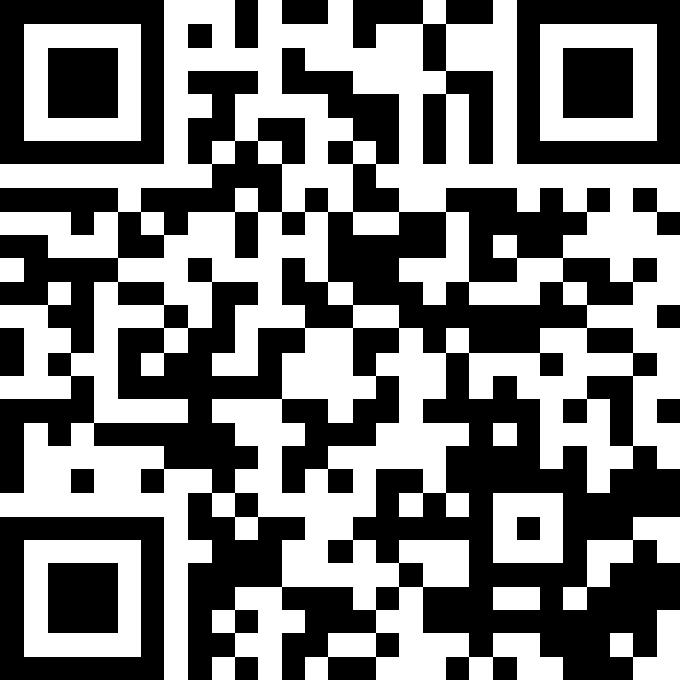
QR CODE
Please ask your questions throughout the presentation. We will take 30 minutes at the end to answer your questions.
Slido code: # 1848635

Slide 5
Introduction to NEB Prizes
QUESTIONS?
Slido code: # 1848635

Slide 6
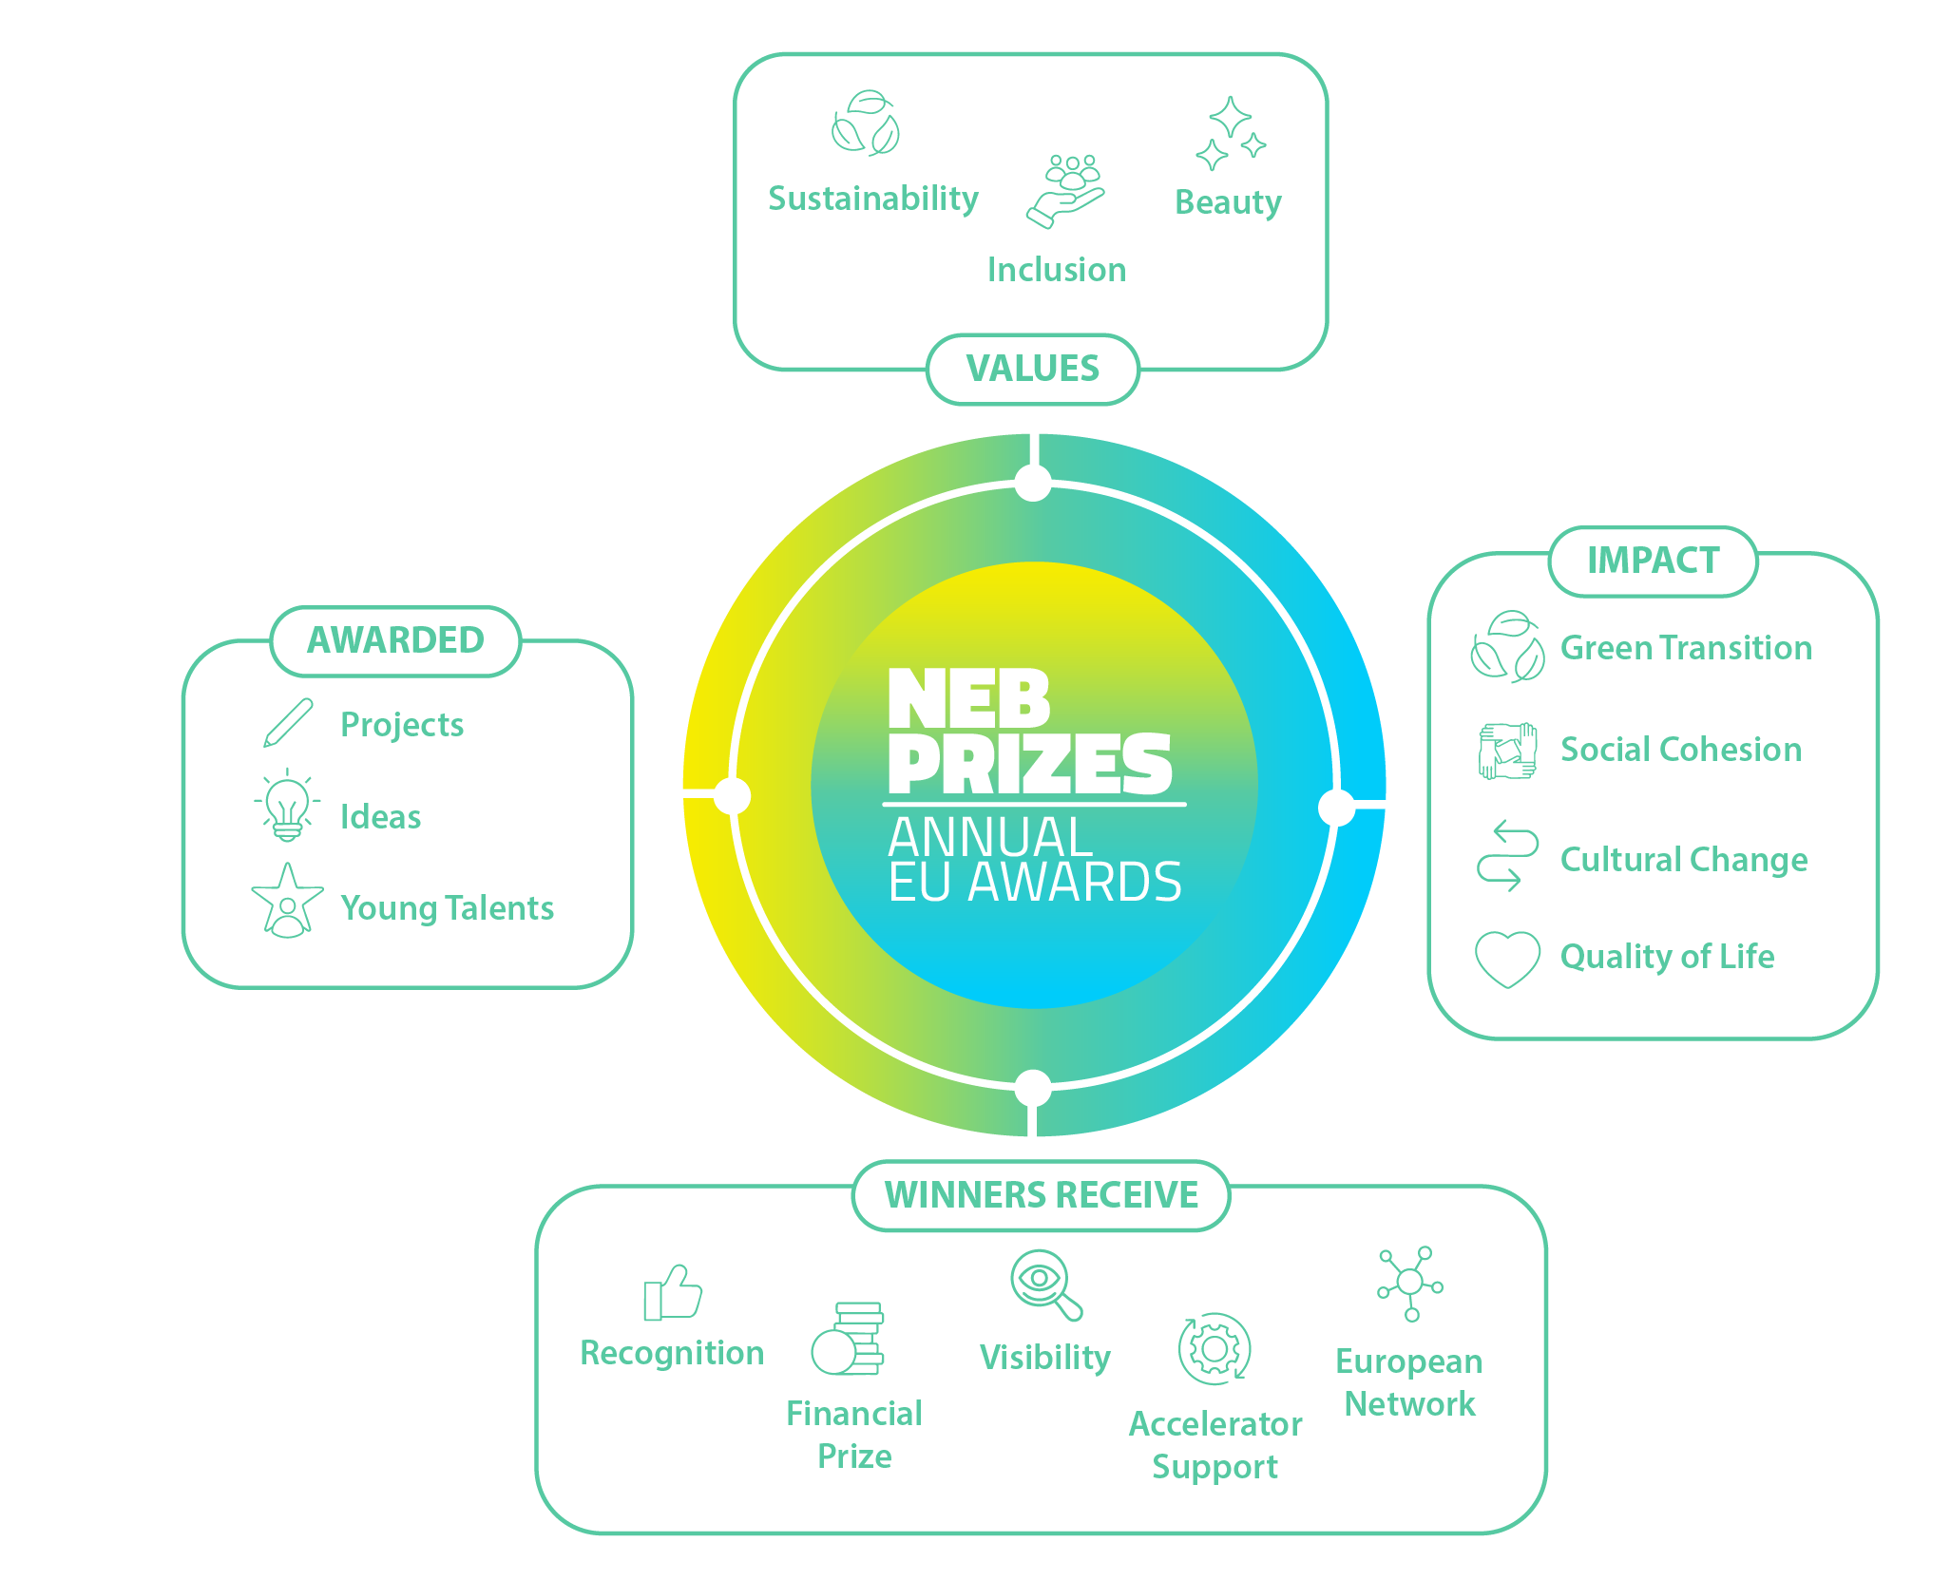
What are
the NEB Prizes?
STRAND A - Champions
STRAND B – Rising stars

Slide 7
What is new in the NEB Prizes 2026 edition?
Special prize: WATER RESILIENCE
International dimension: NEB Prizes in BRAZIL & JAPAN
Support to finalists: ACCELERATOR PROGRAMME
The Prizes welcome applications from MOLDOVA

Slide 8
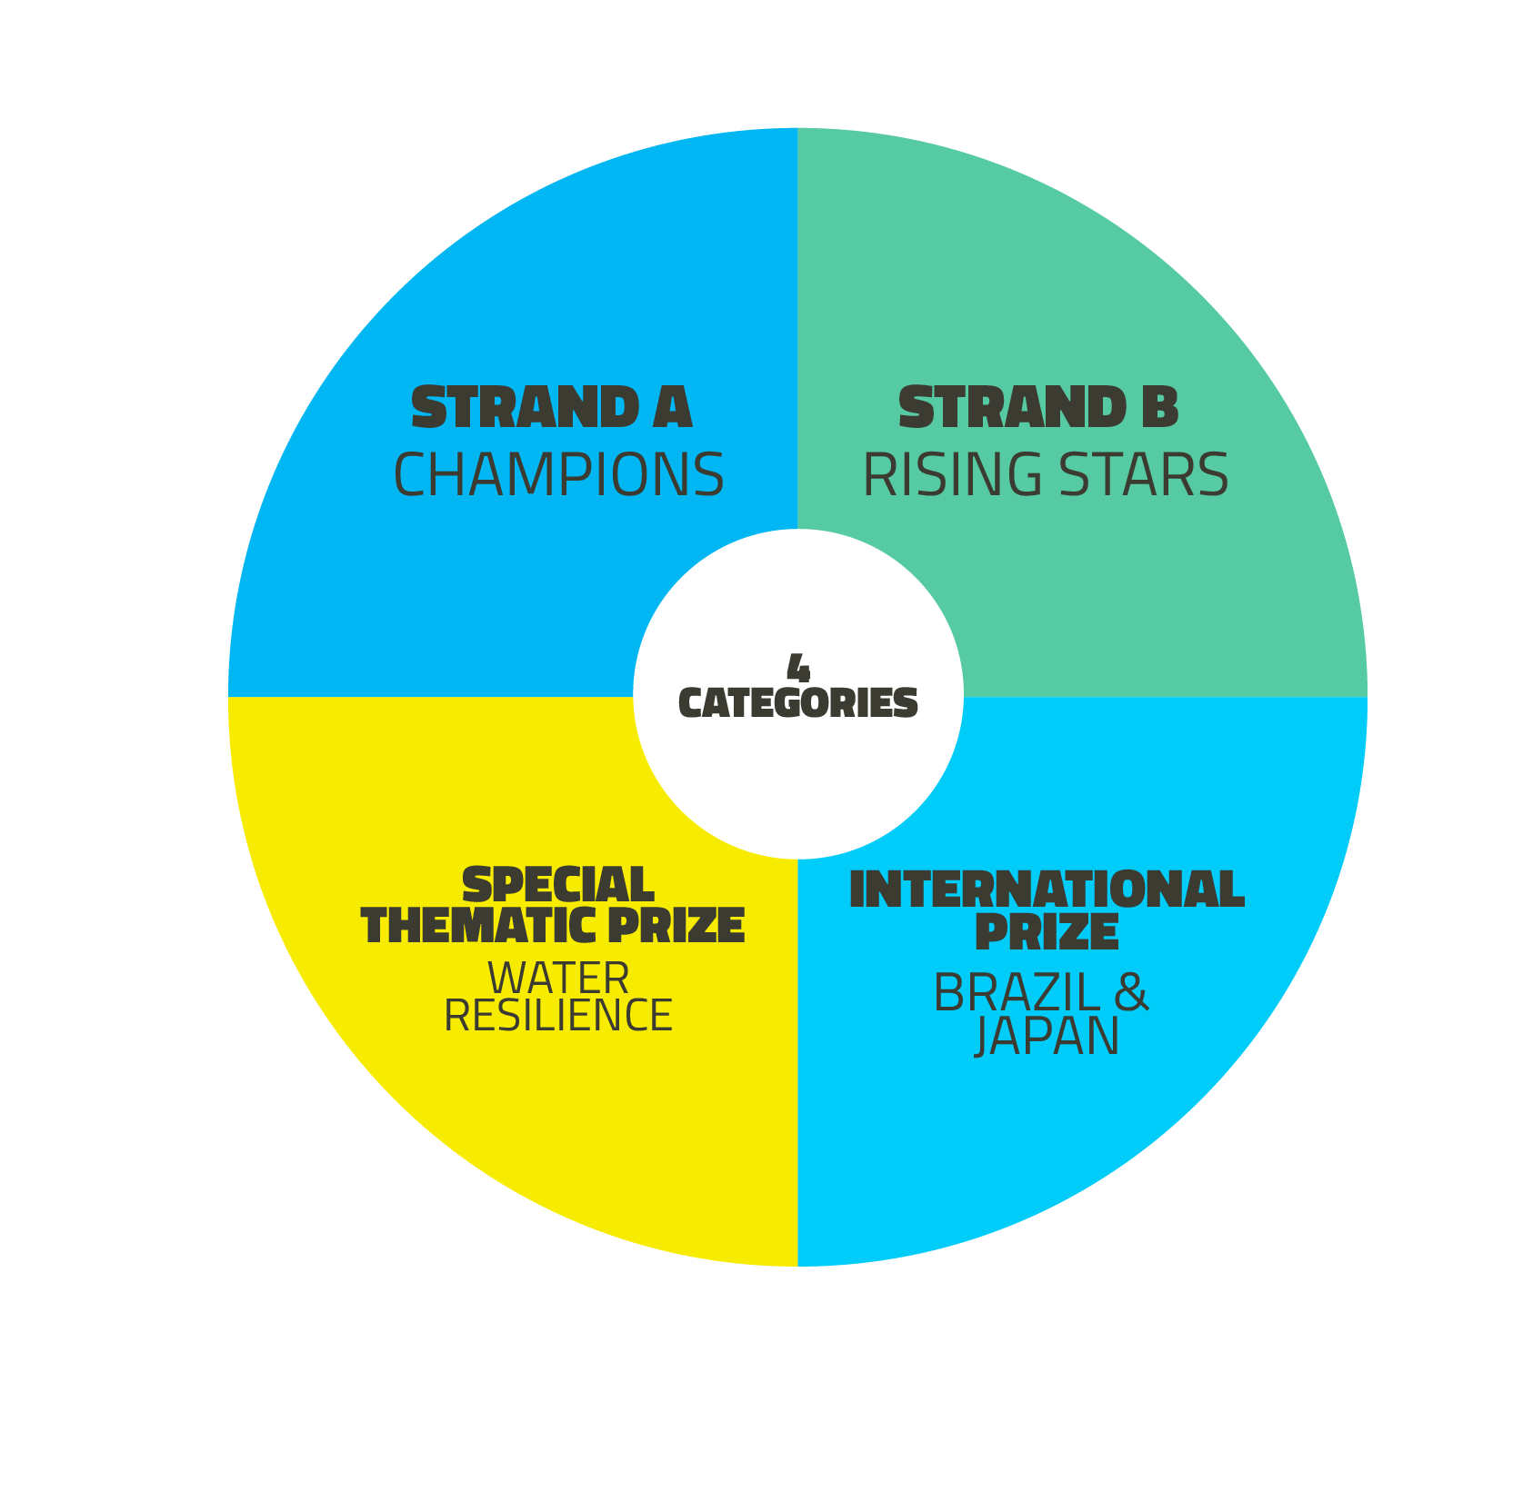
NEB Prizes 2026 edition at a glance
4 Category winners
20 000 € each
1 Public vote winner
20 000 €
4 Runners-up
5000 € each
4 Category winners
15 000 € each
1 Public vote winner
15 000 €
4 Runners-up
5000 € each
1 Winner
20 000 €
2 Runners-up
5000 € each
2 Winners
20 000 € each
4 Runners-up
5000 € each

Slide 9
What type of projects or concepts?
The project or concept integrates and promotes the NEB values and working principles, and improves - or aims to improve - the quality of life for people and communities in the long term.
Each application must be related to a specific location or region, with a clear target group and defined objectives.
Projects or concepts that cannot be replicated in other contexts are not eligible.

Slide 10

The 4 Prize Categories
Enhancing Circularity, Sustainability, and Innovation

Slide 11

The 4 Prize Categories
Enhancing Circularity, Sustainability, and Innovation
Strengthening Local Democracy and Inclusion

Slide 12

The 4 Prize Categories
Enhancing Circularity, Sustainability, and Innovation
Strengthening Local Democracy and Inclusion
Arts, Culture, and Heritage as Drivers of Change

Slide 13

The 4 Prize Categories
Enhancing Circularity, Sustainability, and Innovation
Strengthening Local Democracy and Inclusion
Arts, Culture, and Heritage as Drivers of Change
Enablers for New European Bauhaus Transformation

Slide 14
Eligibility criteria
The following slides provide a high-level overview of the eligibility criteria. The full and legally binding eligibility conditions are set out in the official guidance documents
QUESTIONS?
Slido code: # 1848635

Slide 15
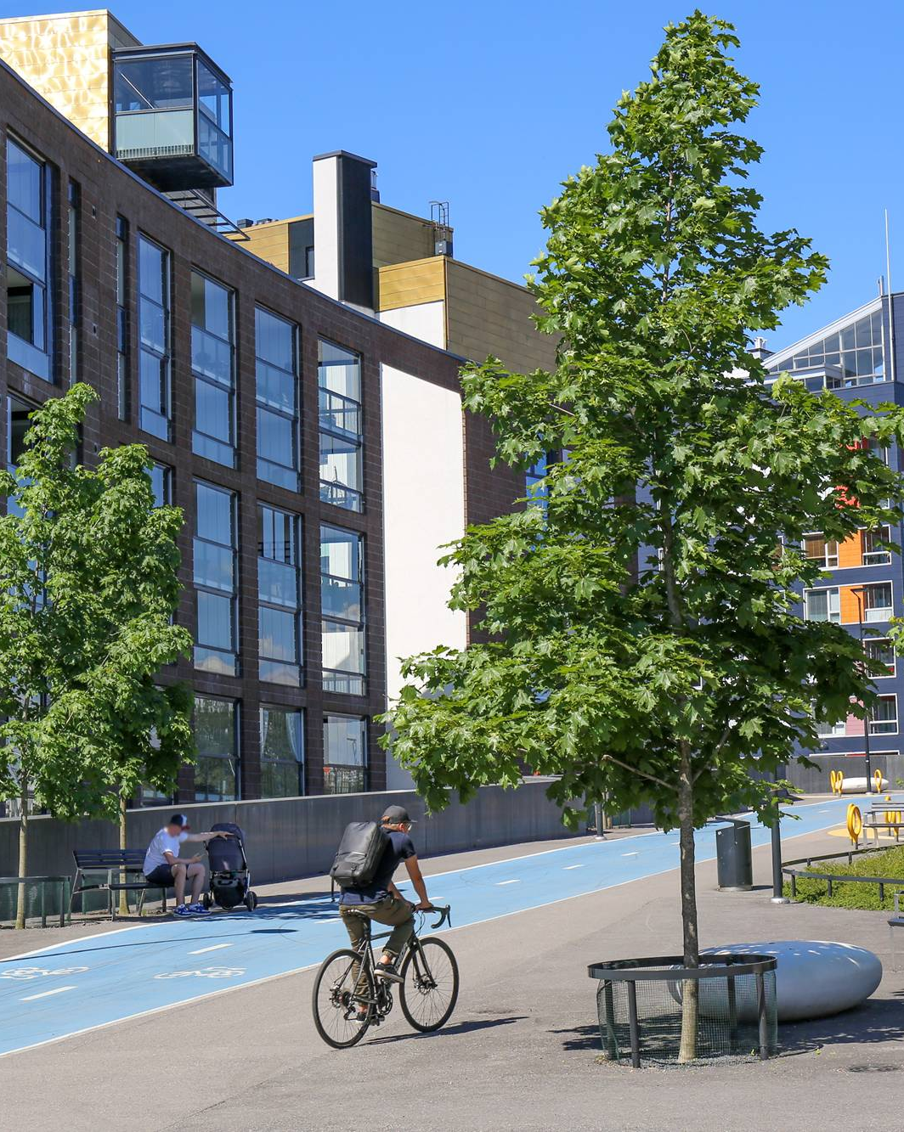
STRAND A - Champions
Strand A awards existing, completed projects that are already implemented and can show positive results.

Slide 16
STRAND A - Champions
Who can apply?
Applicants can be an individual, a public authority, a non-profit organisation, or a private entity representing an existing or completed project.
Applicants can be EU or non-EU residents, if their projects are implemented in the EU, in the Western Balkans, Moldova, or in Ukraine.
Applicants are not eligible if they have received a monetary EU prize. However, projects that have previously received public funding, including from the EU, (e.g. a grant) are eligible, so long that they have not won a monetary EU prize.

Slide 17
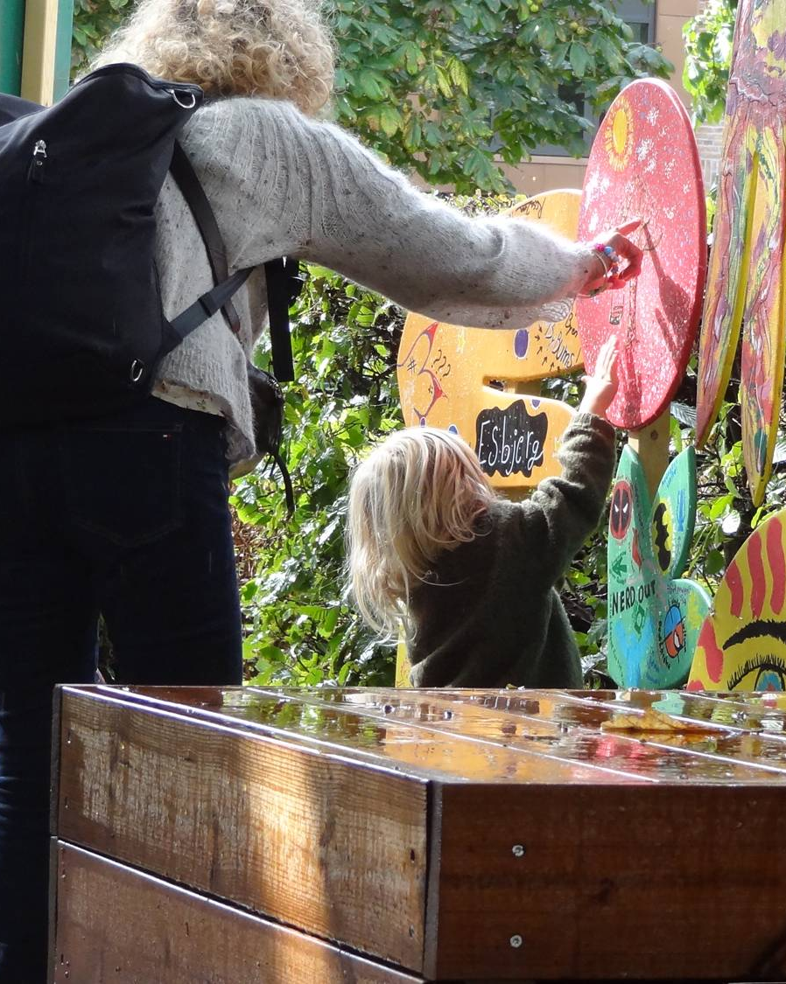
STRAND B –
Rising Stars
Strand B rewards promising concepts and early-stage initiatives developed by young and promising talents (from ideas to prototypes) that are not necessarily completed yet but show strong potential and a clear plan to be brought to life.

Slide 18
STRAND B – Rising Stars
Who can apply?
Applicants must be 30 years old or younger on the final day of the call for applications, including all representatives of the organisation involved in the creation of the given concept.
Applicants can be an individual or organisation (public, private, or non-profit) that has developed promising concepts and early-stage initiatives.
Applicants can be EU or non-EU residents, if their projects are implemented in the EU, in the Western Balkans, Moldova, or in Ukraine.

Slide 19
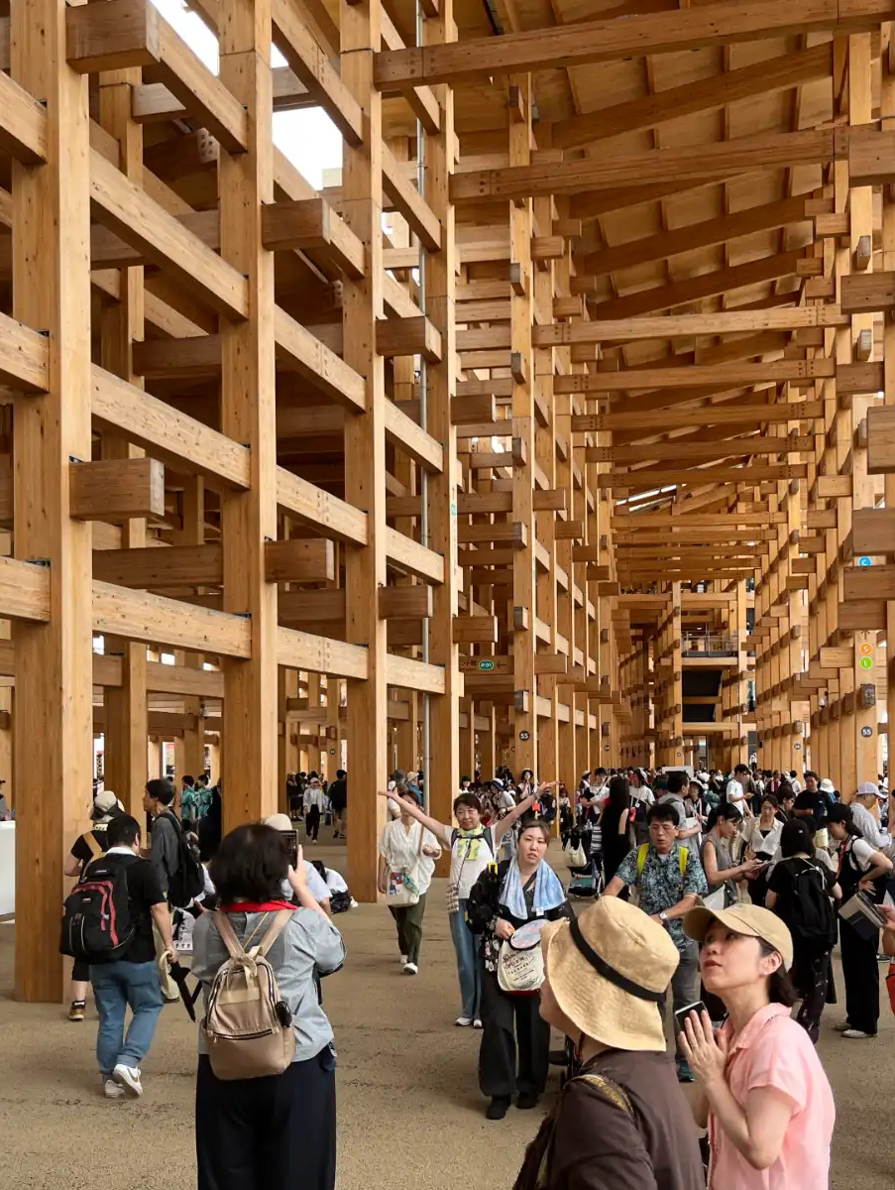
INTERNATIONAL PRIZES –
Brazil & Japan
The 2026 edition of the NEB Prizes will reward and celebrate Brazilian and Japanese existing projects (Strand A)
and ideas from young people (Strand B)
that embody the New European Bauhaus values (sustainable, inclusive, beautiful) and its working principles: a participatory process, multi-level engagement, and a transdisciplinary approach.

Slide 20
INTERNATIONAL PRIZES – Brazil & Japan
Who can apply?
Applicants for Strand A and Strand B may be individuals, public authorities, non-profit organisations, or private entities that are nationals of, legally established in, and operating in Brazil or Japan, and that represent an existing and completed project implemented exclusively in the same country.
In addition, for Strand B : applicants in this strand, including any co-authors involved in the creation of the given concept, must be 30 years old or younger on the final day of call for applications.

Slide 21
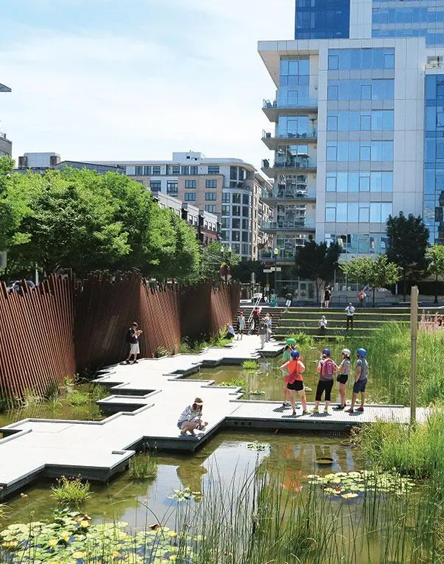
SPECIAL THEMATIC PRIZE–
Water Resilience
The 2026 edition of the NEB Prizes will reward and celebrate
existing projects (Strand A)
and ideas from young people (Strand B) that address challenges related to water resilience : from climate adaptation and sustainable water management to community preparedness.

Slide 22
THEMATIC PRIZE– Water Resilience
Who can apply?
Applicants for Strand A and Strand B if they state they want to apply to the Special Prize

Slide 23
Award criteria
QUESTIONS?
Slido code: # 1848635

Slide 24
Award Criteria
The quality assessment of applications will be conducted by external, independent experts based on the following award criteria :
Results, outputs, or impact (10 / 100 points)
Exemplary character in the 3 core values of NEB (40 / 100 points)
Exemplary character in the 3 main working principles of NEB (35 / 100 points)
Innovative dimension (5 / 100 points)
EU Competitiveness (5 / 100 points)
High potential for transferability (5 / 100 points).

Slide 25
Additional Criteria
Considering the ranking of applications based on the award criteria listed above, the final proposal by the jury will also consider the following additional criteria:
Geographical diversity
Balance between applications referring to physical transformation of the built environment (‘hard investments’) and other types of transformations (‘soft investments’)
Diversity of contexts (urban, rural, urban-rural linkages)

Slide 26
Timeline
QUESTIONS?
Slido code: # 1848635

Slide 27
Timeline
ACCELERATOR PROGRAMME
For finalists in the EU
CALL OPEN PERIOD
Launch: 20 February 2026
Deadline: 17 March 2026
ANOUCEMENT OF FINALISTS & PUBLIC VOTING
June-July
ANOUCEMENT OF WINNERS
Award ceremony (autumn 2026)
SELECTION
April-May

Slide 28
Useful tools
QUESTIONS?
Slido code: # 1848635

Slide 29
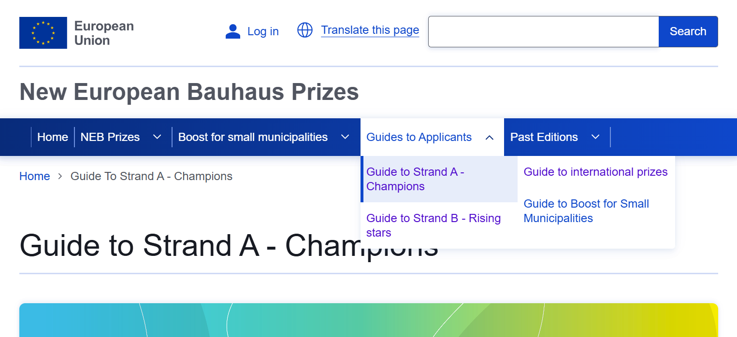
Guides to applicants
On the NEB Prizes webpage, you can find guides to applicants for each prize https://prizes.new-european-bauhaus.europa.eu/

Slide 30
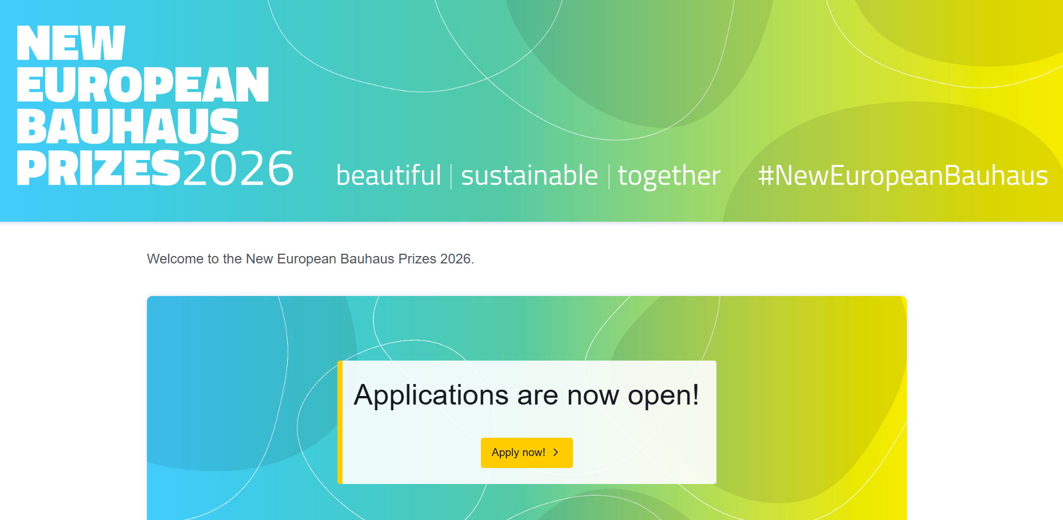
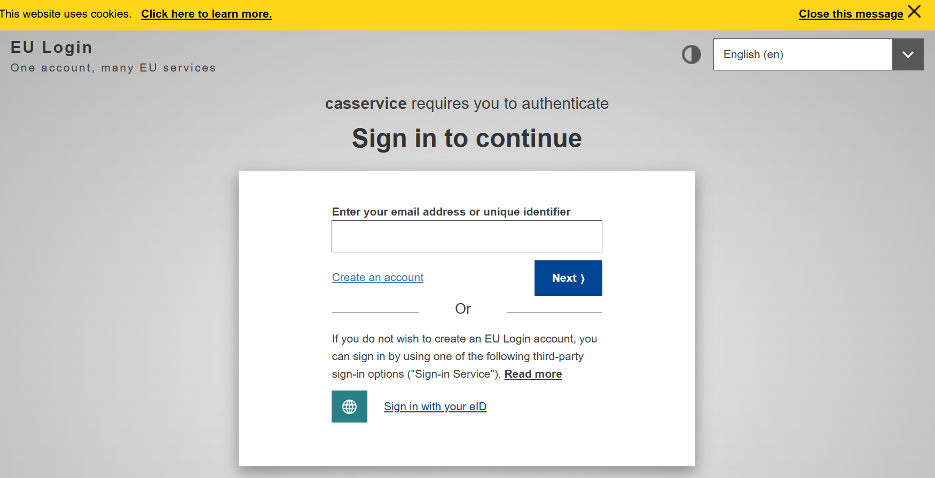
Online Application Form
Your application must be submitted online. Use the « Apply now » button on the home page of the NEB Prizes website
You will be redirected to the online platform to fill in the application form

Slide 31
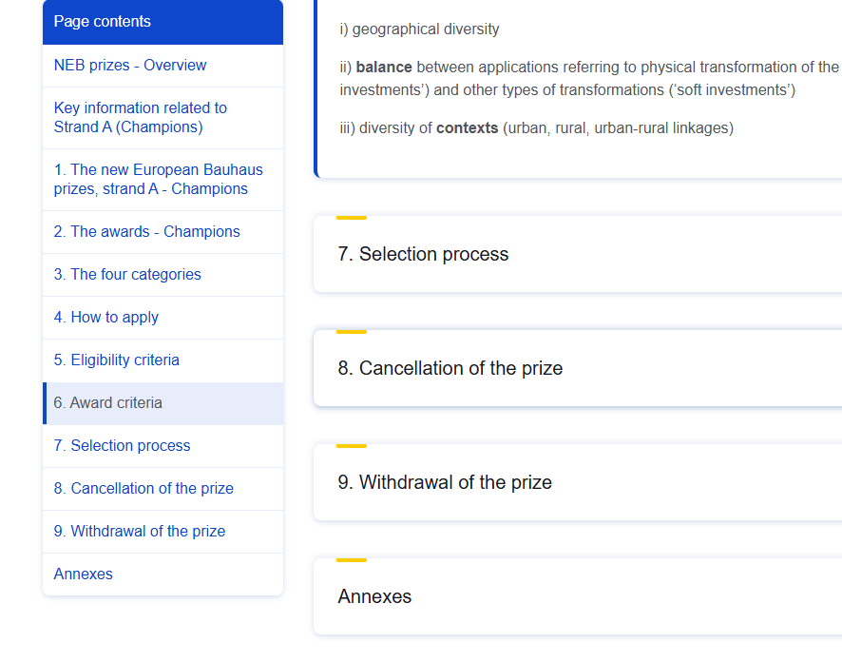
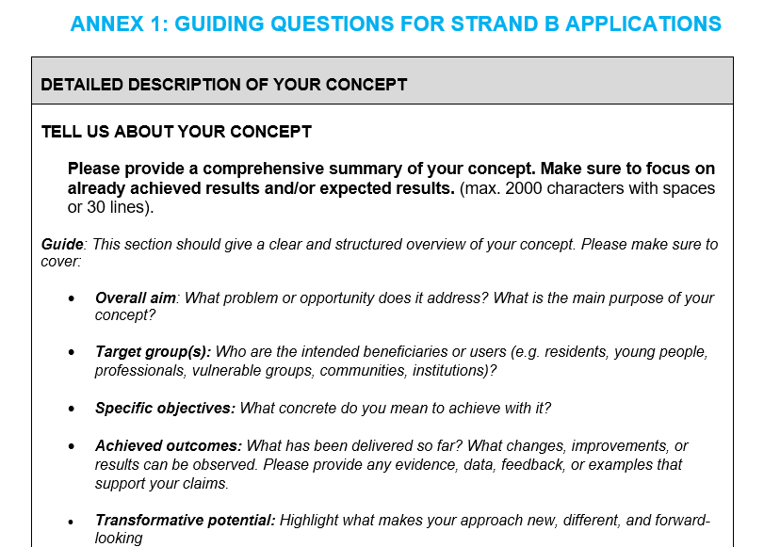
Guiding questions to fill in the application
In the Annex of each guide, you will find guiding questions to help you through the application process:
On Wednesday 11th of March from 1 to 3PM CET, we will hold an NEB Bootcamp to deep dive into these guiding questions

Slide 32
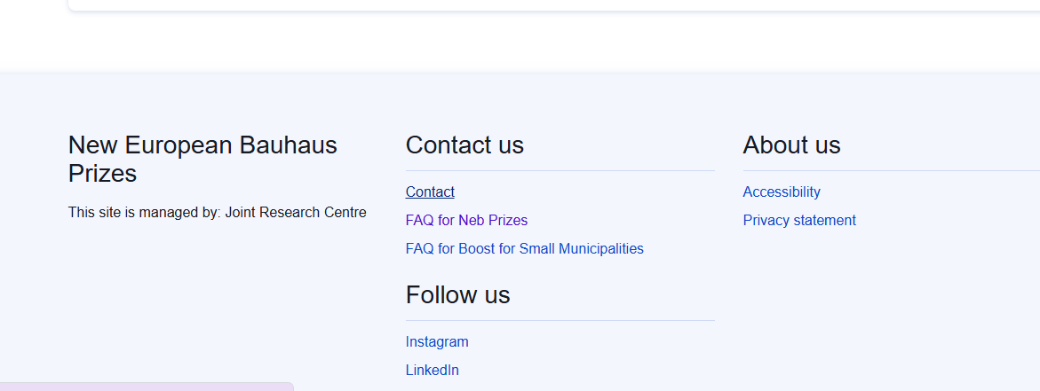
Other existing resources
On the New European Bauhaus general page https://new-european-bauhaus.europa.eu/tools-and-resources_en
NEB compass, which outlines the values and working principles of the initiative and illustrates diverse levels of ambition
NEB checklist to test the coherence of your application.
on the NEB Prizes website: https://prizes.new-european-bauhaus.europa.eu/
Examples of winning applications are available
FAQ and contact form
Home page of the NEB Prizes website

Slide 33
Q&A

Slide 34
QR CODE
Please ask your questions throughout the presentation. We will take 30 minutes at the end to answer your questions.
Slido code: # 1848635

Slide 35
THANK YOU!

